Slide 1
Optimal Bounds on the Price of Fairness for Indivisible Goods
Umang Bhaskar (TIFR)
with Siddharth Barman (IISc), Nisarg Shah (UToronto)
ReLaX Workshop, February 2021

Slide 2








Fair Division
classical problem
references in the Bible, greek mythology, …
mathematically studied since 1950s for a divisible resource (modeled by cake)
more recent work in game theory on indivisible resources
practical applications, e.g.,

Slide 3









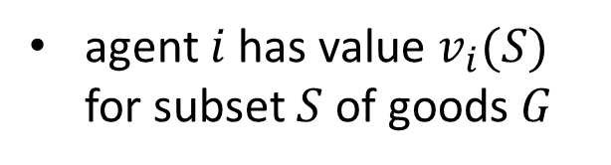
Fair Division
$n$ agents, $m$ goods, $G$ is set of indivisible goods
agent $i$ has value $v_{i}(S)$
for subset $S$ of goods $G$
$$v_{i}\left(S\right)$$
$$S$$
(publicly known)

Slide 4
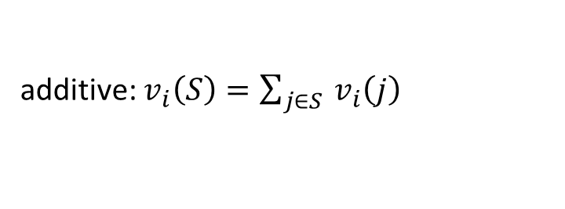


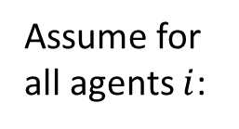

Fair Division
$n$ agents, $m$ goods, $G$ is set of indivisible goods
agent $i$ has value $v_{i}(S)$
for subset $S$ of goods $G$
$$v_{i}\left(S\right)$$
$$S$$
(publicly known)
additive: $v_{i}\left(S\right)=\sum_{j∈S }{v_{i}\left(j\right)}$
scaled: $v_{i}\left(G\right)=1$
how do we fairly allocate the goods?
Assume for all agents $i$:
$v_{i}\left(∅\right)=0$
$v_{i}\left(∅\right)$ is monotone

Slide 5

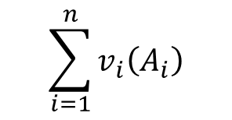
Social Welfare
Option 1:
Maximize social welfare
$$v_{i}\left(S\right)$$
$$S$$
Allocation $A=\left(A_{1},…, A_{n}\right)$ to maximize
$$\sum_{i=1}^{n}{v_{i}\left(A_{i}\right)}$$

Slide 6




$v_{green}\left(⋅\right)=100$, $v_{red}\left(⋅\right)=10$, $v_{blue}\left(⋅\right)=1$
Social Welfare
additive utilities
Option 1:
Maximize social welfare
100
(assigns all goods to green agent)
Allocation $A=\left(A_{1},…, A_{n}\right)$ to maximize
$$\sum_{i=1}^{n}{v_{i}\left(A_{i}\right)}$$
10
1

Slide 7
$v_{green}\left(⋅\right)=100$, $v_{red}\left(⋅\right)=10$, $v_{blue}\left(⋅\right)=1$
Social Welfare
additive utilities
Option 1:
Maximize social welfare
100
(assigns all goods to green agent)
Not fair, but…
10
economically efficient
(is Pareto-optimal: any other allocation leaves some agent worse off)
1
very well-studied (hardness, approximation algorithms known)

Slide 8
Fairness Notions
We look at two common fairness notions:
1. Envy-freeness (EF)
(no agent wants what another agent has)
2. Maximin share guarantee (MMS)
(every agent gets at least a basic minimum)
(but such allocations may not exist, hence consider relaxations)

Slide 9



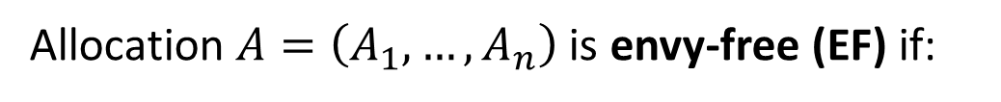
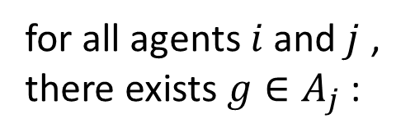
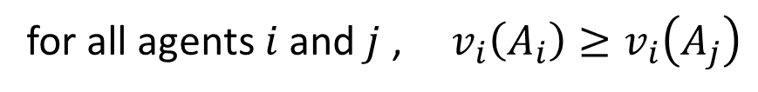
Envy-Freeness
Allocation $A=\left(A_{1},…, A_{n}\right)$ is envy-free (EF) if:
for all agents $i$ and $j$ , $v_{i}\left(A_{i}\right)≥v_{i}\left(A_{j}\right)$
but such an allocation may not exist, e.g.,
1
1
Allocation $A=\left(A_{1},…, A_{n}\right)$ is envy-free up to 1 good (EF1) if:
for all agents $i$ and $j$ , there exists $g∈A_{j}$ :
$$v_{i}\left(A_{i}\right)≥v_{i}\left(A_{j}−g\right)$$

Slide 10






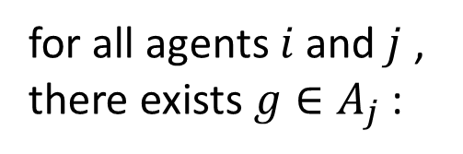

Envy-Freeness
Allocation $A=\left(A_{1},…, A_{n}\right)$ is envy-free up to 1 good (EF1) if:
for all agents $i$ and $j$ , there exists $g∈A_{j}$ :
$$v_{i}\left(A_{i}\right)≥v_{i}\left(A_{j}−g\right)$$
10
6
6
1
3
4
1
3
identical, additive valuations
10
4

Slide 11
Envy-Freeness
Allocation $A=\left(A_{1},…, A_{n}\right)$ is envy-free up to 1 good (EF1) if:
for all agents $i$ and $j$ , there exists $g∈A_{j}$ :
$$v_{i}\left(A_{i}\right)≥v_{i}\left(A_{j}−g\right)$$
always exist, can be efficiently computed
for monotone valuations
for additive valuations, EF1 + PO allocations exist,
given by Nash Social Welfare optimal allocation
[CKM+ `16, BKV `18]

Slide 12
Fairness Notions
We look at two common fairness notions:
✓
1. Envy-freeness (EF)
(no agent wants what another agent has)
2. Maximin share guarantee (MMS)
(every agent gets at least a basic minimum)
(but such allocations may not exist, hence consider relaxations)

Slide 13
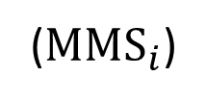
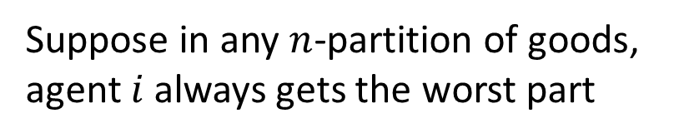
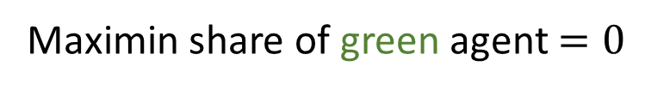
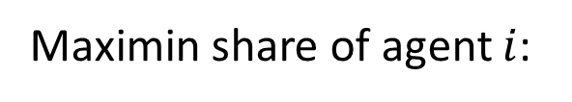
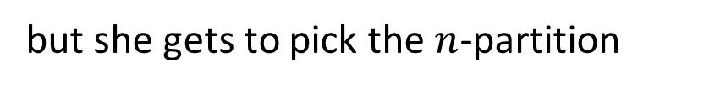
Maximin Share
Maximin share of agent $i$:
Suppose in any $n$-partition of goods, agent $i$ always gets the worst part
(${MMS}_{i}$)
but she gets to pick the $n$-partition
what value can she guarantee herself?
1
1
0
Maximin share of green agent $=0$

Slide 14

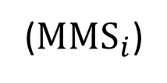

Maximin Share
Maximin share of agent $i$:
Suppose in any $n$-partition of goods, agent $i$ always gets the worst part
(${MMS}_{i}$)
but she gets to pick the $n$-partition
what value can she guarantee herself?
10
6
1
10
6
1
3
4
3
Maximin share of green agent $≥6$
4

Slide 15

Maximin Share
Maximin share of agent $i$:
Suppose in any $n$-partition of goods, agent $i$ always gets the worst part
(${MMS}_{i}$)
but she gets to pick the $n$-partition
what value can she guarantee herself?
10
6
1
10
6
1
3
4
3
Maximin share of green agent $=7$
4

Slide 16
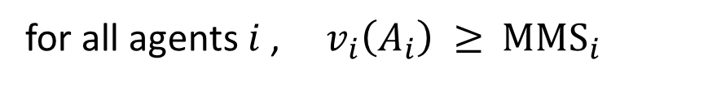
MMS Allocation
Maximin share of agent $i$:
Suppose in any $n$-partition of goods, agent $i$ always gets the worst part
(${MMS}_{i}$)
but she gets to pick the $n$-partition
what value can she guarantee herself?
Allocation $A=\left(A_{1},…, A_{n}\right)$ is a maximin share (MMS) allocation if:
for all agents $i$ , $v_{i}\left(A_{i}\right) ≥{ MMS}_{i}$
(every agent gets at least her maximin share guarantee)
… but such an allocation may not exist
[PW `14, KPW `16]

Slide 17

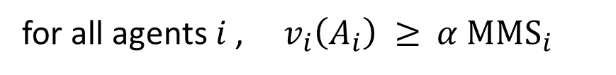
MMS Allocation
Maximin share of agent $i$:
Suppose in any $n$-partition of goods, agent $i$ always gets the worst part
(${MMS}_{i}$)
but she gets to pick the $n$-partition
what value can she guarantee herself?
Allocation $A=\left(A_{1},…, A_{n}\right)$ is an $α$-maximin share (MMS) allocation if:
for all agents $i$ , $v_{i}\left(A_{i}\right) ≥{ α MMS}_{i}$
(every agent gets at least
$α×$her maximin share guarantee)

Slide 18
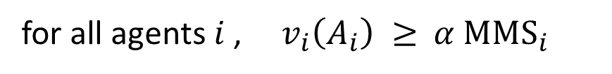
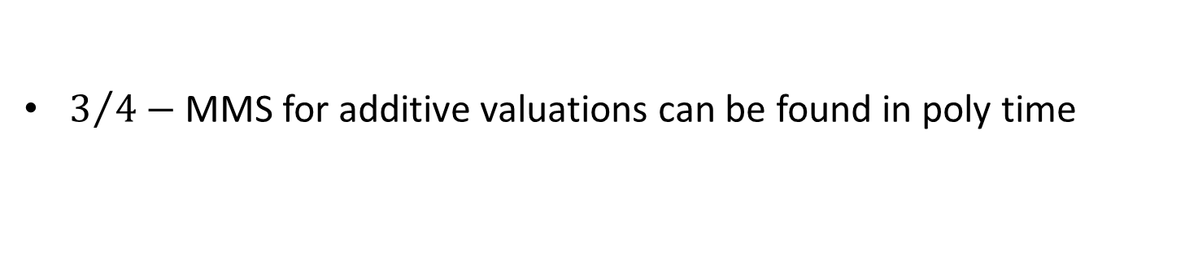

MMS Allocation
Allocation $A=\left(A_{1},…, A_{n}\right)$ is an $α$-maximin share (MMS) allocation if:
for all agents $i$ , $v_{i}\left(A_{i}\right) ≥{ α MMS}_{i}$
(every agent gets at least
$α×$her maximin share guarantee)
generalizes the ‘cut-and-choose’ protocol for cake-cutting:
one agent cuts the cake into two pieces,
the other agent chooses her preferred piece
$3/4−$ MMS for additive valuations can be found in poly time
[GHS+ `18, GT `20]

Slide 19
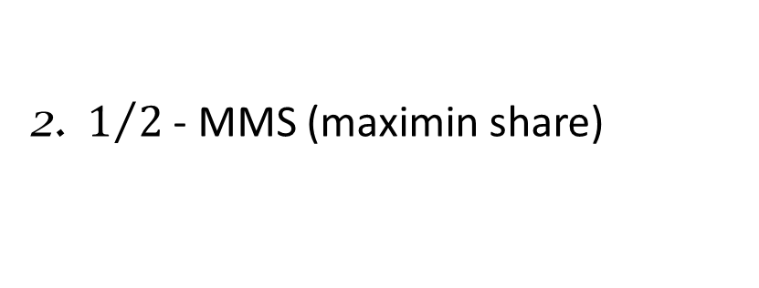
EF1 and ½ - MMS
Two common fairness notions:
1. EF1 (envy-free up to 1 good)
6
1
3
4
(no agent wants what another agent has,
after removing one good)
10
2. $1/2$ - MMS (maximin share)
10
6
1
3
4
(every agent gets at least ½ her maximin share guarantee)

Slide 20
Fairness Notions
Other fairness notions:
EFX, GMMS, EQ, …
3
4
6
1
(future work?)
10
10
6
1
3
4

Slide 21
$v_{green}\left(⋅\right)=100$, $v_{red}\left(⋅\right)=10$, $v_{blue}\left(⋅\right)=1$
Social Welfare
additive utilities
Maximizing social welfare assigns all goods to green agent
100
Very unfair to other agents
If we insist on fairness,
what is effect on social welfare?
10
1

Slide 22
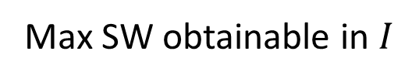


$v_{green}\left(⋅\right)=100$, $v_{red}\left(⋅\right)=10$, $v_{blue}\left(⋅\right)=1$
Price of Fairness
additive utilities
Maximizing social welfare assigns all goods to green agent
Very unfair to other agents
If we insist on fairness,
what is effect on social welfare?
Max SW obtainable in $I$
Price of
EF1 / ½-MMS
= max
$$≥ 1$$
instance $I$
Max SW obtainable in
EF1 / ½-MMS allocation
similar to Price of Stability studied for equilibria in games

Slide 23
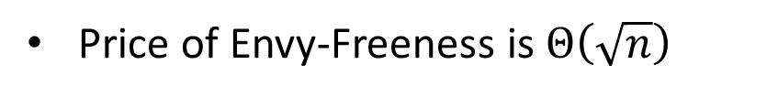
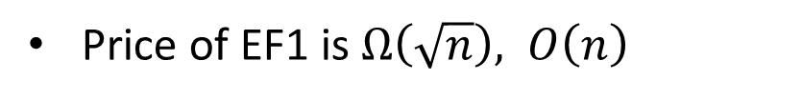
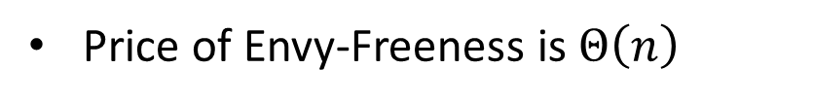
Previous Work
For divisible goods:
Price of Envy-Freeness is $Θ\left(\sqrt{n}\right)$
[CKKP `12, BFT `11]
For indivisible goods:
Price of Envy-Freeness is $Θ\left(n\right)$
[CKKP `12]
(for instances where EF allocation exists)
Price of EF1 is $Ω\left(\sqrt{n}\right), O\left(n\right)$
[BLMS `19]
(also obtain bounds on Nash Social Welfare, Leximin, … )
Price of Fairness also studied for chores, machine scheduling, networking, …
[CKKP `12, HvS `15, BFFMM `16]
Notes:
CKKP: Caragiannis, I., Kaklamanis, C., Kanellopoulos, P., Kyropoulou, M.: The efficiency of fair division, TOCS 2012
BFT: Bertsimas, D., Farias, V.F., Trichakis, N.: The price of fairness. OR 2011
BLMS: Bei, X., Lu, X., Manurangsi, P., Suksompong, W.: The price of fairness for indivisible goods, IJCAI 2019
HvS: Heydrich and van Stee, Dividing connected chores fairly ToCS 2015
BFFMM: Vittorio Bil`o, Angelo Fanelli, Michele Flammini, Gianpiero Monaco, and Luca Moscardelli. The price of envy-freeness in machine scheduling. ToCS 2016

Slide 24
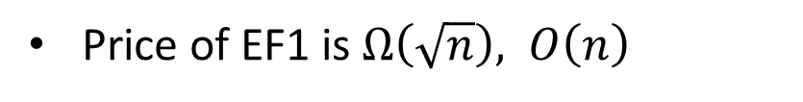
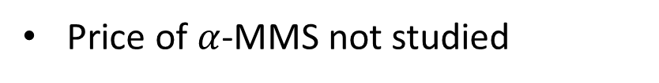
Previous Work
For indivisible goods:
Price of EF1 is $Ω\left(\sqrt{n}\right), O\left(n\right)$
[BLMS `19]
(also obtain bounds on Nash Social Welfare, Leximin, … )
Price of $α$-MMS not studied
Notes:
BLMS: Bei, X., Lu, X., Manurangsi, P., Suksompong, W.: The price of fairness for indivisible goods, IJCAI 2019

Slide 25
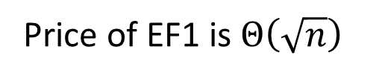

Our Results
1
Price of EF1 is $Θ\left(\sqrt{n}\right)$
for all classes of valuations between additive and subadditive
$v_{i}\left(⋅\right)$ subadditive if $v_{i}\left(S\right)+v_{i}\left(T\right)≥v_{i}\left(S∪T\right)$
additive $⊆$ submodular $⊆$ subadditive
Notes:
LMMS: Lipton, R.J., Markakis, E., Mossel, E., Saberi, A.: On approximately fair allocations of indivisible goods EC ’04
ABKR: Arunachaleswaran, E.R., Barman, S., Kumar, R., Rathi, N.: Fair and efficient cake division with connected pieces WINE 2019
F: Feige On maximizing welfare when utility functions are subadditive. SIAM Journal on Computing 2009
AMNS: Amanatidis, G., Markakis, E., Nikzad, A., Saberi, A.: Approximation algorithms for computing maximin share allocations TALG 2017

Slide 26

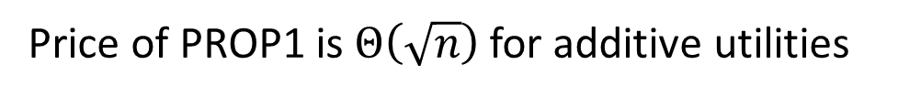
Our Results
1
Price of EF1 is $Θ\left(\sqrt{n}\right)$
for all classes of valuations between additive and subadditive
Price of PROP1 is $Θ\left(\sqrt{n}\right)$ for additive utilities
2
Price of ½ - MMS is $Θ\left(\sqrt{n}\right)$ for additive utilities
lower bounds from earlier work
[BLMS `19]
upper bound through polytime constructions
use multiple results, ideas from previous work
[LMMS `04, ABKR `19, F `09, AMNS `17, …]
Notes:
LMMS: Lipton, R.J., Markakis, E., Mossel, E., Saberi, A.: On approximately fair allocations of indivisible goods EC ’04
ABKR: Arunachaleswaran, E.R., Barman, S., Kumar, R., Rathi, N.: Fair and efficient cake division with connected pieces WINE 2019
F: Feige On maximizing welfare when utility functions are subadditive. SIAM Journal on Computing 2009
AMNS: Amanatidis, G., Markakis, E., Nikzad, A., Saberi, A.: Approximation algorithms for computing maximin share allocations TALG 2017

Slide 27
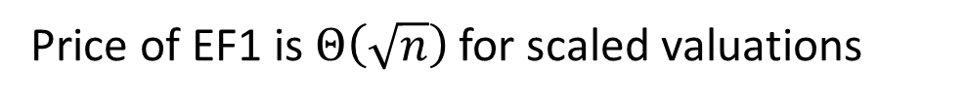
Talk Outline
1
Price of EF1 is $Θ\left(\sqrt{n}\right)$ for scaled valuations
This talk:
Price of EF1 is $O\left(n\right)$ for unscaled valuations
i. algorithm by LMMS for extending an EF1 allocation
ii. $O\left(n\right)$ bound on Price of EF1 for unscaled valuations
Notes:
BLMS: Bei, X., Lu, X., Manurangsi, P., Suksompong, W.: The price of fairness for indivisible goods, IJCAI 2019

Slide 28
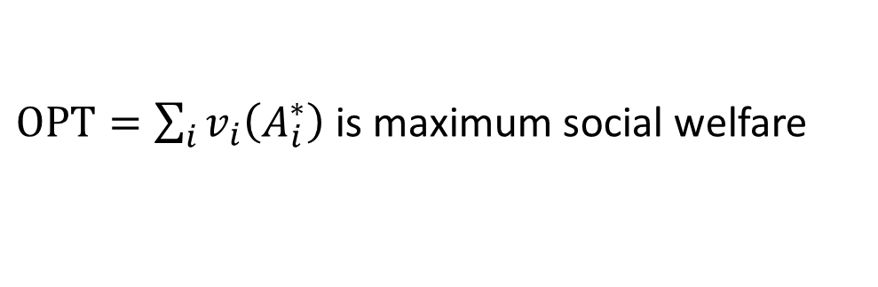
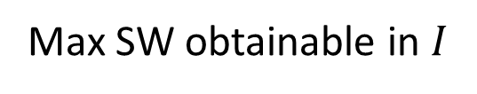
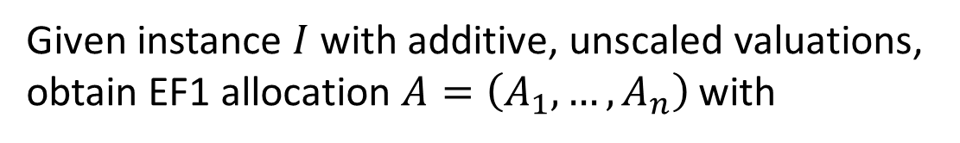
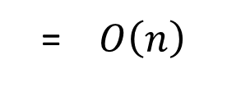
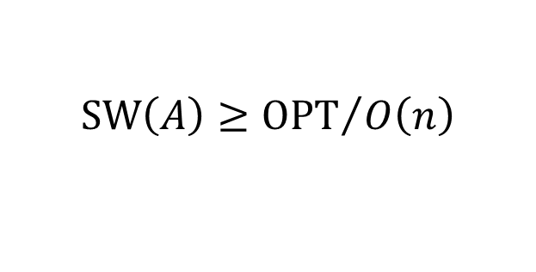

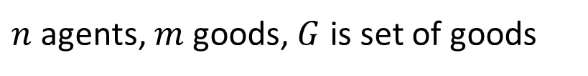
Setup
Max SW obtainable in $I$
Price of EF1
= max
= $O\left(n\right)$
instance $I$
Max SW obtainable in
EF1
$n$ agents, $m$ goods, $G$ is set of goods
For instance $I$, $A^{∗}=\left(A_{1}^{∗} , A_{2}^{∗}, …, A_{n}^{∗}\right)$ is SW-maximizing allocation
$OPT=\sum_{i}{v_{i}\left(A_{i}^{∗}\right)}$ is maximum social welfare
Goal:
Given instance $I$ with additive, unscaled valuations,
obtain EF1 allocation $A=\left(A_{1}, …, A_{n}\right)$with
$$SW\left(A\right)≥{OPT}/{O\left(n\right)}$$
Notes:
BLMS: Bei, X., Lu, X., Manurangsi, P., Suksompong, W.: The price of fairness for indivisible goods, IJCAI 2019

Slide 29
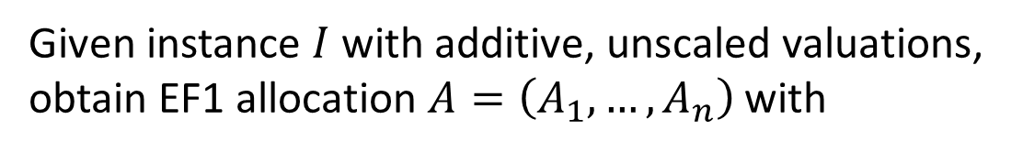
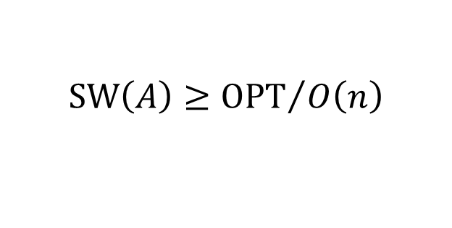
Steps
Goal:
Given instance $I$ with additive, unscaled valuations,
obtain EF1 allocation $A=\left(A_{1}, …, A_{n}\right)$with
$$SW\left(A\right)≥{OPT}/{O\left(n\right)}$$
i. algorithm by LMMS for extending an EF1 allocation
ii. $O\left(n\right)$ bound on Price of EF1 for unscaled valuations
Notes:
BLMS: Bei, X., Lu, X., Manurangsi, P., Suksompong, W.: The price of fairness for indivisible goods, IJCAI 2019

Slide 30
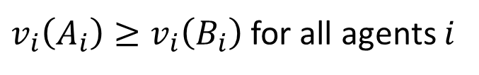


LMMS Algorithm
Extends a partial EF1 allocation to a complete EF1 allocation
Input:
A partial EF1 allocation $B=\left(B_{1}, …, B_{n}\right)$ of goods $G$
${(B}_{1}∪…∪B_{n}) ⊂G$
(partial)
Output:
A complete EF1 allocation $A=\left(A_{1}, …, A_{n}\right)$ of goods $G$ s.t.
$v_{i}\left(A_{i}\right)≥v_{i}\left(B_{i}\right)$ for all agents $i$
(each agent’s value increases)
${(A}_{1}∪…∪A_{n})= G$
(complete)
Notes:
BLMS: Bei, X., Lu, X., Manurangsi, P., Suksompong, W.: The price of fairness for indivisible goods, IJCAI 2019

Slide 31
Steps
Goal:
Given instance $I$ with additive, unscaled valuations,
obtain EF1 allocation $A=\left(A_{1}, …, A_{n}\right)$with
$$SW\left(A\right)≥{OPT}/{O\left(n\right)}$$
✓
i. algorithm by LMMS for extending an EF1 allocation
ii. an $O\left(n\right)$ bound on Price of EF1 for unscaled valuations
Notes:
BLMS: Bei, X., Lu, X., Manurangsi, P., Suksompong, W.: The price of fairness for indivisible goods, IJCAI 2019

Slide 32







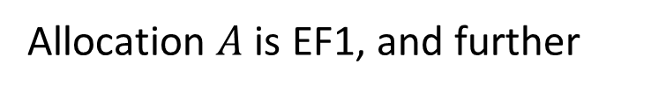
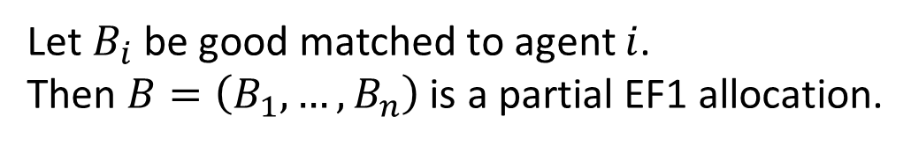
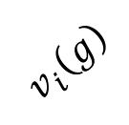
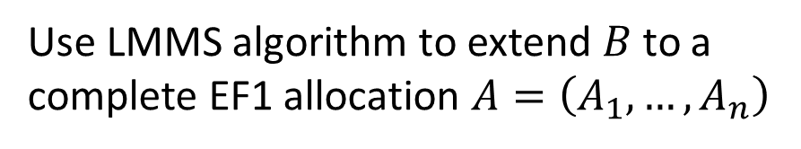
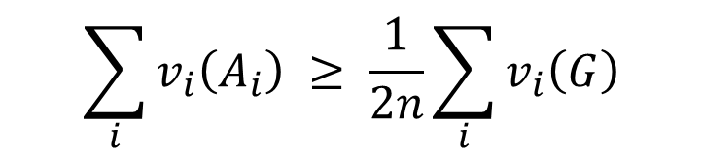
Unscaled Valuations
Algo:
Step 1:
Do a max-weight matching in complete b.p. graph with agents and goods
$$v_{i}\left(g\right)$$
Let $B_{i}$ be good matched to agent $i$.
Then $B=\left(B_{1}, …, B_{n}\right)$ is a partial EF1 allocation.
Step 2:
Use LMMS algorithm to extend $B$to a complete EF1 allocation $A=\left(A_{1}, …, A_{n}\right)$
Theorem 1:
Allocation $A$ is EF1, and further
$$\sum_{i}{v_{i}\left(A_{i}\right)} ≥ \frac{1}{2n}\sum_{i}{v_{i}\left(G\right)}$$

Slide 33
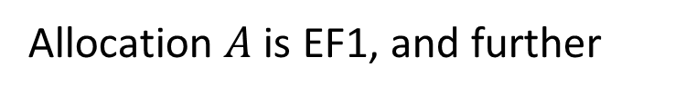
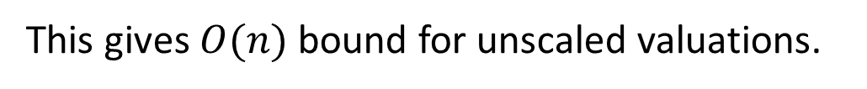
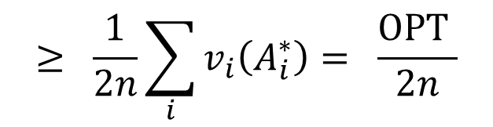
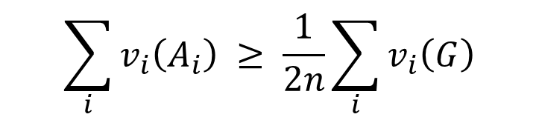
Unscaled Valuations
Theorem 1:
Allocation $A$ is EF1, and further
$$\sum_{i}{v_{i}\left(A_{i}\right)} ≥ \frac{1}{2n}\sum_{i}{v_{i}\left(G\right)}$$
$$≥ \frac{1}{2n}\sum_{i}{v_{i}\left(A_{i}^{∗}\right)}= \frac{OPT }{2n}$$
(proof skipped)
This gives $O(n)$ bound for unscaled valuations.

Slide 34
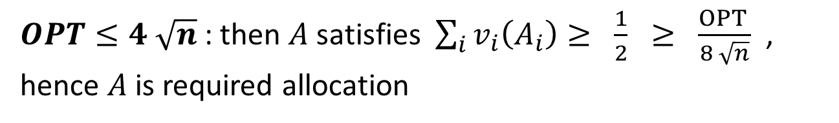

Scaled Valuations
Theorem 1:
Allocation $A$ is EF1, and further
$$\sum_{i}{v_{i}\left(A_{i}\right)} ≥ \frac{1}{2n}\sum_{i}{v_{i}\left(G\right)}$$
$$≥ \frac{1}{2n}\sum_{i}{v_{i}\left(A_{i}^{∗}\right)}= \frac{OPT }{2n}$$
Consider scaled valuations, $v_{i}\left(G\right)=1$ for all agents $i$.
Theorem 1 gives an EF1 allocation $A$ s.t. $\sum_{i}{v_{i}\left(A_{i}\right) ≥ \frac{1}{2}}$
Case 1:
$OPT≤4 \sqrt{n}$: then $A$ satisfies $\sum_{i}{v_{i}\left(A_{i}\right)≥ \frac{1}{2}} ≥ \frac{OPT }{8 \sqrt{n}}$ ,
hence $A$ is required allocation
Case 2:
$$OPT>4 \sqrt{n}$$

Slide 35
Steps
Goal:
Given instance $I$ with additive, unscaled valuations,
obtain EF1 allocation $A=\left(A_{1}, …, A_{n}\right)$with
$$SW\left(A\right)≥{OPT}/{O\left(n\right)}$$
✓
i. algorithm by LMMS for extending an EF1 allocation
✓
ii. an $O\left(n\right)$ bound on Price of EF1 for unscaled valuations
Notes:
BLMS: Bei, X., Lu, X., Manurangsi, P., Suksompong, W.: The price of fairness for indivisible goods, IJCAI 2019

Slide 36
Our Results
1
Price of EF1 is $Θ\left(\sqrt{n}\right)$
for all classes of valuations between additive and subadditive
Price of PROP1 is $Θ\left(\sqrt{n}\right)$ for additive utilities
2
Price of ½ - MMS is $Θ\left(\sqrt{n}\right)$ for additive utilities
lower bounds from earlier work
[BLMS `19]
upper bound through polytime constructions
use multiple results, ideas from previous work
[LMMS `04, ABKR `19, F `09, AMNS `17, …]
Notes:
LMMS: Lipton, R.J., Markakis, E., Mossel, E., Saberi, A.: On approximately fair allocations of indivisible goods EC ’04
ABKR: Arunachaleswaran, E.R., Barman, S., Kumar, R., Rathi, N.: Fair and efficient cake division with connected pieces WINE 2019
F: Feige On maximizing welfare when utility functions are subadditive. SIAM Journal on Computing 2009
AMNS: Amanatidis, G., Markakis, E., Nikzad, A., Saberi, A.: Approximation algorithms for computing maximin share allocations TALG 2017

Slide 37
Open Questions
1
Price of other fairness notions?
2
Price of EF1 + PO?
3
Price of fairness in voting / matching ?
Thank You!
Notes:
LMMS: Lipton, R.J., Markakis, E., Mossel, E., Saberi, A.: On approximately fair allocations of indivisible goods EC ’04
ABKR: Arunachaleswaran, E.R., Barman, S., Kumar, R., Rathi, N.: Fair and efficient cake division with connected pieces WINE 2019
F: Feige On maximizing welfare when utility functions are subadditive. SIAM Journal on Computing 2009
AMNS: Amanatidis, G., Markakis, E., Nikzad, A., Saberi, A.: Approximation algorithms for computing maximin share allocations TALG 2017

