Slide 1
Partial Function Extension with Applications
Umang Bhaskar
Gunjan Kumar
Tata Institute of Fundamental Research

Slide 2



Partial Function Extension
Given points
$T_{1}, T_{2}, …, T_{n}$
from domain D
values
$f_{1}, f_{2}, …, f_{n}$
at the given points
and family F of functions,
Does there exist function $f∈$F defined on D that
satisfies $f\left(T_{i}\right)=f_{i}$ for $i=1 …n$ ?
(i.e., extends the given partial function)

Slide 3

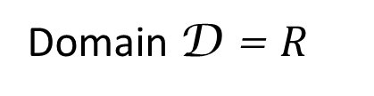
Example: Convex Functions
Domain D = $R$
Family F : convex functions
Partial function:
Partial function:
$$\left(0,1\right), \left(2,2\right), (4,2)$$
2
1
Not Extendible
0
2
4

Slide 4

Example: Convex Functions
Domain D = $R$
Family F : convex functions
Partial function:
Partial function:
$$\left(0,1\right), \left(2,1\right), (4,2)$$
2
1
0
2
4

Slide 5
Example: Convex Functions
Domain D = $R$
Family F : convex functions
Partial function:
Partial function:
$$\left(0,1\right), \left(2,1\right), (4,2)$$
2
1
Extendible
0
2
4

Slide 6





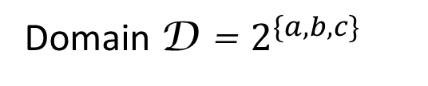








Example: Monotone Functions
Domain D = $2^{\{a,b,c\}}$
$$5$$
$$abc$$
Family F : monotone functions
Partial function:
Partial function:
$$ab$$
$$ac$$
$$bc$$
$\left(∅,0\right), \left(\{a\},6\right), (\left\{b\right\},5), \left(\left\{a,b,c\right\},5\right)$
$$a$$
$$5$$
$$6$$
$$b$$
$$c$$
Not Extendible
$$0$$
$$∅$$

Slide 7

Example: Monotone Functions
Domain D = $2^{\{a,b,c\}}$
$$5$$
$$abc$$
Family F : monotone functions
Partial function:
Partial function:
$$ab$$
$$ac$$
$$bc$$
$\left(∅,0\right), \left(\{a\},6\right), (\left\{b\right\},5), \left(\left\{a,b,c\right\},5\right)$
$$a$$
$$5$$
$$1$$
$$b$$
$$c$$
$$0$$
$$∅$$

Slide 8




Example: Monotone Functions
Domain D = $2^{\{a,b,c\}}$
$$5$$
$$abc$$
Family F : monotone functions
Partial function:
Partial function:
$$5$$
$$ab$$
$$1$$
$$5$$
$$ac$$
$$bc$$
$\left(∅,0\right), \left(\{a\},6\right), (\left\{b\right\},5), \left(\left\{a,b,c\right\},5\right)$
$$a$$
$$5$$
$$1$$
$$b$$
$$0$$
$$c$$
Extendible
$$0$$
$$∅$$

Slide 9
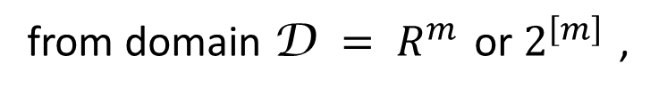
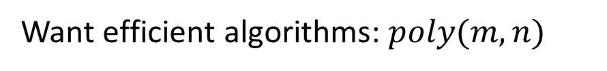
Partial Function Extension
Given partial function
$H=\left\{\left(T_{1},f_{1}\right), \left(T_{2}, f_{2}\right), …, {(T}_{n}, f_{n}\right)\}$
from domain D $= R^{m}$ or $2^{\left[m\right]}$ ,
and family F of functions,
Does there exist function $f∈$F defined on D that extends $H$?
Want efficient algorithms: $poly(m,n)$

Slide 10
Approximate Extension
Given partial function
$H=\left\{\left(T_{1},f_{1}\right), \left(T_{2}, f_{2}\right), …, {(T}_{n}, f_{n}\right)\}$
from domain D $= R^{m}$ or $2^{\left[m\right]}$ ,
and family F of functions,
Minimize $α$ such that, for some $f∈$F ,
$f_{i} ≤ f\left(T_{i}\right) ≤ α f_{i}$ for $i=1 … n$

Slide 11
Application I: Lower Bounds for PAC Learning

Slide 12
Application I: Lower Bounds for PAC Learning
For family F of functions, domain D $= 2^{\left[m\right]}$ ,
F is $α$– PAC learnable if , for any $f^{∗}∈$ F, distribution $μ$ over $2^{\left[m\right]}$,
$f^{∗}$ can be learned within a factor of $α$ w.h.p., from $poly(m)$ samples

Slide 13


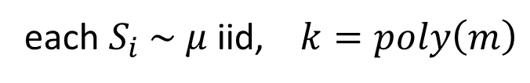
Application I: Lower Bounds for PAC Learning
For family F of functions, domain D $= 2^{\left[m\right]}$ ,
F is $α$– PAC learnable if , for any $f^{∗}∈$ F, distribution $μ$ over $2^{\left[m\right]}$,
$f^{∗}$ can be learned within a factor of $α$ w.h.p., from $poly(m)$ samples
$\left(S_{1},f^{∗}\left(S_{1}\right)\right), \left(S_{2},f^{∗}\left(S_{2}\right)\right), …, \left(S_{k}, f^{∗}\left(S_{k}\right)\right)$
Learning Algorithm
$f^{∗}$
$$f$$
each $S_{i} \sim μ$ iid, $k=poly\left(m\right)$
$f\left(S\right) ≤ f^{∗}\left(S\right) ≤ α f\left(S\right)$ w.h.p. for $S \sim μ$

Slide 14
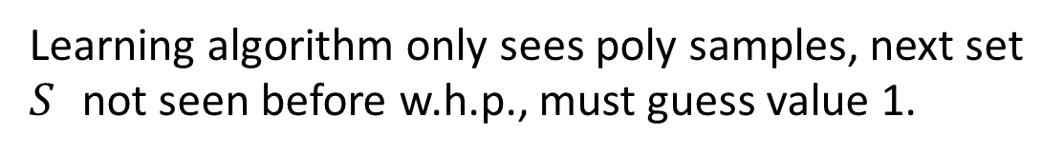
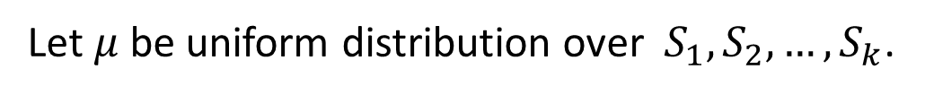
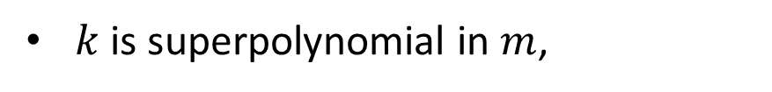
Application I: Lower Bounds for PAC Learning
Suppose for family F of functions, domain D $= 2^{\left[m\right]}$ ,
there exist values $r>1,$ $\left(S_{1},S_{2},…, S_{k}\right)⊆$D such that:
$k$ is superpolynomial in $m$,
for any $f_{1},f_{2},…, f_{k}∈[1,r]$, partial function $\left\{\left(S_{1},f_{1}\right), \left(S_{2},f_{2}\right), …\left(S_{k}, f_{k}\right)\right\}$ is extendible,
then family F cannot be PAC-learned with factor $<r$.
Let $μ$ be uniform distribution over $S_{1},S_{2},…, S_{k}$.
Learning algorithm only sees poly samples, next set $S$ not seen before w.h.p., must guess value 1.

Slide 15
Application II: Property Testing

Slide 16



Application II: Property Testing
For family F of functions, domain D $= 2^{\left[m\right]}$ ,
$$S_{1},S_{2},…, S_{k}$$
Testing Algorithm
$f^{∗}$
$$f^{∗}\left(S_{1}\right), f^{∗}\left(S_{2}\right), …,f^{∗}(S_{k})$$
determine with $o(2^{m})$ queries if $f^{∗}∈$F, or if far from F
$f^{∗}$ is $ε$-far from F if ($ε 2^{m}$) values must be changed to be in F

Slide 17
Application II: Property Testing
For family F of functions, domain D $= 2^{\left[m\right]}$ ,
$$S_{1},S_{2},…, S_{k}$$
Testing Algorithm
$f^{∗}$
$$f^{∗}\left(S_{1}\right), f^{∗}\left(S_{2}\right), …,f^{∗}(S_{k})$$
determine with $o(2^{m})$ queries if $f^{∗}∈$F, or if far from F
If partial fn $\left(S_{1},f^{∗}\left(S_{1}\right)\right), …, \left(S_{k}, f^{∗}\left(S_{k}\right)\right)$ can be extended to F, algo must say $f^{∗}∈$F

Slide 18

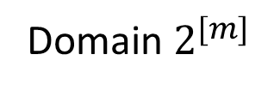
Relevant Families F
Domain $2^{[m]}$
Subadditive functions
$$f\left(S\right)+f\left(T\right) ≥ f\left(S∪T\right)$$
(complement-free)

Slide 19




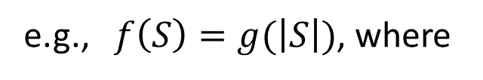
Relevant Families F
Domain $2^{[m]}$
Subadditive functions
$$f\left(S\right)+f\left(T\right) ≥ f\left(S∪T\right)$$
(complement-free)
e.g., $f\left(S\right)=g(\left|S\right|)$, where
3
3
✓
2
2
$g(\left|S\right|)$
$g(\left|S\right|)$
1
1
0
1
2
3
4
0
1
2
3
4
$\left|S\right|$
$\left|S\right|$

Slide 20

Relevant Families F
Domain $2^{[m]}$
Subadditive functions
$$f\left(S\right)+f\left(T\right) ≥ f\left(S∪T\right)$$
(complement-free)
Submodular functions
$f\left(S\right)+f\left(T\right) ≥ f\left(S∪T\right)+f\left(S∩T\right)$
or
$f\left(S∪i\right)−f\left(S\right) ≥ f\left(S∪j∪i\right)−f\left(S∪j\right)$
(diminishing marginal returns)

Slide 21




Relevant Families F
Domain $2^{[m]}$
Subadditive functions
$$f\left(S\right)+f\left(T\right) ≥ f\left(S∪T\right)$$
(complement-free)
Submodular functions
$f\left(S\right)+f\left(T\right) ≥ f\left(S∪T\right)+f\left(S∩T\right)$
or
$f\left(S∪i\right)−f\left(S\right) ≥ f\left(S∪j∪i\right)−f\left(S∪j\right)$
(diminishing marginal returns)
3
3
✓
2
2
$g(\left|S\right|)$
$g(\left|S\right|)$
1
1
0
1
2
3
4
0
1
2
3
4
$\left|S\right|$
$\left|S\right|$

Slide 22
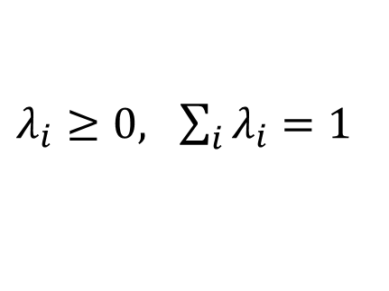
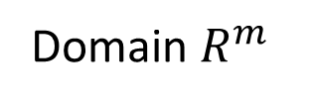
Relevant Families F
Domain $2^{[m]}$
Subadditive functions
$$f\left(S\right)+f\left(T\right) ≥ f\left(S∪T\right)$$
(complement-free)
Submodular functions
$f\left(S\right)+f\left(T\right) ≥ f\left(S∪T\right)+f\left(S∩T\right)$
or
$f\left(S∪i\right)−f\left(S\right) ≥ f\left(S∪j∪i\right)−f\left(S∪j\right)$
(diminishing marginal returns)
Domain $R^{m}$
Convex functions
$λ_{1}f\left(S_{1}\right)+…+λ_{k}f\left(S_{k}\right) ≥ f\left(λ_{1}S_{1}+ …+λ_{k}S_{k}\right)$
$λ_{i}≥0, \sum_{i}{λ_{i}}=1$

Slide 23
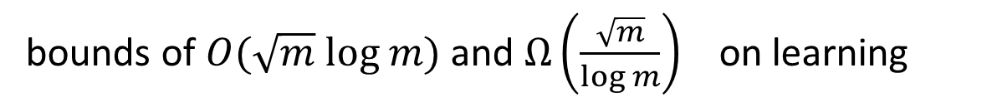
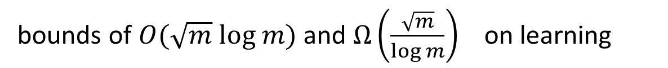
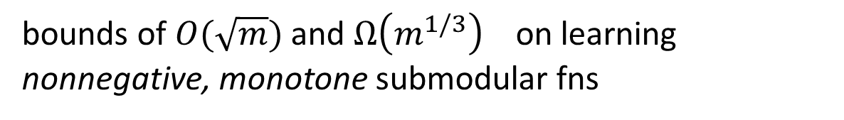
Previous Work
bounds of $O(\sqrt{m} log m)$ and $Ω\left(\frac{\sqrt{m}}{log m}\right)$ on learning
bounds of $O(\sqrt{m} log m)$ and $Ω\left(\frac{\sqrt{m}}{log m}\right)$ on learning
Subadditive functions:
[Balcan et al., 2012]
Submodular functions:
bounds of $O(\sqrt{m})$ and $Ω\left(m^{1/3}\right)$ on learning nonnegative, monotone submodular fns
[Balcan, Harvey, 2011]
tester that makes $ε^{−O\left(\sqrt{m} log m\right)}$ queries
[Seshadhri, Vondrak, 2014]
Convex functions:
partial function extension studied in convex analysis

Slide 24
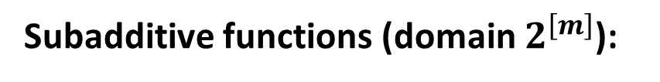


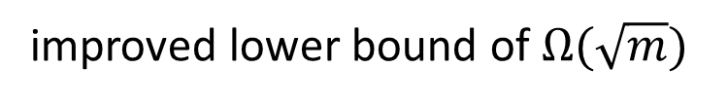
Our Results
Subadditive functions (domain $2^{\left[m\right]}$):
Partial Fn Extn:
coNP-complete
tight bound of $Θ(log m)$ on approximate extension
Learning:
improved lower bound of $Ω(\sqrt{m})$
Testing:
tester that makes $2^{\frac{m}{2}+O\left(\sqrt{m log 1/ε} \right)}$ queries
first nontrivial tester, makes $o\left(2^{m}\right)$queries

Slide 25

Our Results
Submodular functions (general, domain $2^{\left[m\right]}$):
Partial Fn Extn:
always extendible if points $T_{i}$s form an antichain ($T_{i}⊆T_{j} ∀ i, j$)
Learning:
cannot be learned within any factor

Slide 26
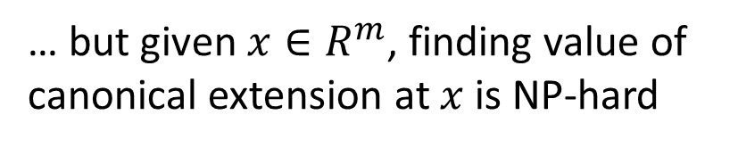
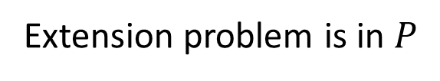

Our Results
Submodular functions (general, domain $2^{\left[m\right]}$):
Partial Fn Extn:
always extendible if points $T_{i}$s form an antichain ($T_{i}⊆T_{j} ∀ i, j$)
Learning:
cannot be learned within any factor
3
2
Convex functions (domain $R^{\left[m\right]}$):
1
Partial Fn Extn:
Extension problem is in $P$
0
1
2
… but given $x∈R^{m}$, finding value of canonical extension at $x$ is NP-hard

Slide 27

Our Results
Submodular functions (general, domain $2^{\left[m\right]}$):
Partial Fn Extn:
always extendible if points $T_{i}$s form an antichain ($T_{i}⊆T_{j} ∀ i, j$)
Learning:
cannot be learned within any factor
?
3
2
Convex functions (domain $R^{\left[m\right]}$):
1
Partial Fn Extn:
Extension problem is in $P$
0
1
2
$$x$$
… but given $x∈R^{m}$, finding value of canonical extension at $x$ is NP-hard

Slide 28
This Talk
Subadditive functions (extension, learning, testing)
Convex functions (extension)

Slide 29
This Talk
Subadditive functions (extension, learning, testing)
Convex functions (extension)

Slide 30
Subadditive Functions
Domain $2^{[m]}$
subadditive functions
$$f\left(S\right)+f\left(T\right) ≥ f\left(S∪T\right)$$
(complement-free)
e.g., $f\left(S\right)=g(\left|S\right|)$, where
3
3
✓
2
2
$g(\left|S\right|)$
$g(\left|S\right|)$
1
1
0
1
2
3
4
0
1
2
3
4
$\left|S\right|$
$\left|S\right|$

Slide 31
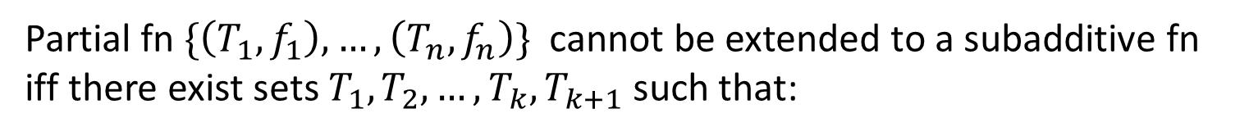

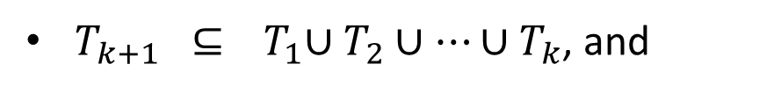
Subadditive Functions: Extension
Theorem:
Subadditive extension is coNP-hard
Tight bound of $Θ(log m)$ on approximate subadditive extension
Lemma:
Partial fn $\{\left(T_{1},f_{1}\right), …, \left(T_{n}, f_{n}\right)\}$ cannot be extended to a subadditive fn
iff there exist sets $T_{1},T_{2},…, T_{k}, T_{k+1}$ such that:
$T_{k+1} ⊆{ T}_{1}∪T_{2}∪…∪T_{k}$, and
$f_{k+1} >{ f}_{1}+f_{2}+…+f_{k}$

Slide 32











Subadditive Functions: Extension
Theorem:
Subadditive extension is coNP-hard
Tight bound of $Θ(log m)$ on approximate subadditive extension
Lemma:
Partial fn $\{\left(T_{1},f_{1}\right), …, \left(T_{n}, f_{n}\right)\}$ cannot be extended to a subadditive fn
iff there exist sets $T_{1},T_{2},…, T_{k}, T_{k+1}$ such that:
$$abc$$
$T_{k+1} ⊆{ T}_{1}∪T_{2}∪…∪T_{k}$, and
$$3$$
$$ab$$
$$1$$
$$ac$$
$$1$$
$$bc$$
$f_{k+1} >{ f}_{1}+f_{2}+…+f_{k}$
$$a$$
$$b$$
$$c$$
(lower bound in theorem from set cover, proof skipped)
not extendible
$$∅$$

Slide 33
Subadditive Functions: Learning
Theorem:
Subadditive functions cannot be learned by any $o(\sqrt{m})$ factor
We use the existence of large $r$-cover free families of sets
A $⊆{ 2}^{\left[m\right]}$ is an $r$-cover free family if any set in the family is not contained in the union of $r$ other sets.
i.e., if $A, A_{1},…, A_{k}∈$ A and $A ⊆ A_{1}∪A_{2}∪ …∪A_{k}$, then $k>r$

Slide 34

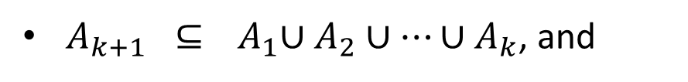
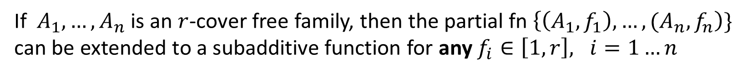
Subadditive Functions: Learning
A $⊆{ 2}^{\left[m\right]}$ is an $r$-cover free family if any set in the family is not contained in the union of $r$ other sets.
i.e., if $A, A_{1},…, A_{k}∈$ A and $A ⊆ A_{1}∪A_{2}∪ …∪A_{k}$, then $k>r$
Lemma:
If $A_{1},…, A_{n}$ is an $r$-cover free family, then the partial fn $\left\{\left(A_{1},f_{1}\right),…, {(A}_{n}, f_{n}\right)\}$ can be extended to a subadditive function for any $f_{i}∈\left[1,r\right], i=1…n$
Proof:
Suppose not extendible. Then there exist sets $A_{1},A_{2},…, A_{k}, A_{k+1}$ s.t.:
$A_{k+1} ⊆{ A}_{1}∪A_{2}∪…∪A_{k}$, and
$f_{k+1} >{ f}_{1}+f_{2}+…+f_{k}$
Since $r$-cover free, $k>r$, hence $f_{k+1}>r+1.$Contradiction.

Slide 35
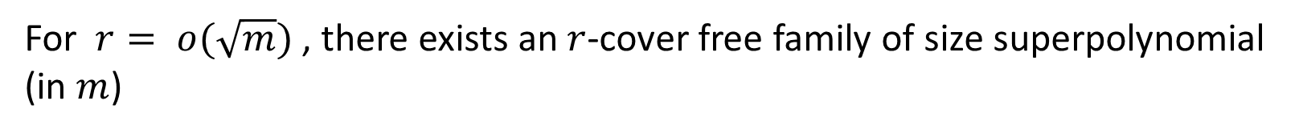
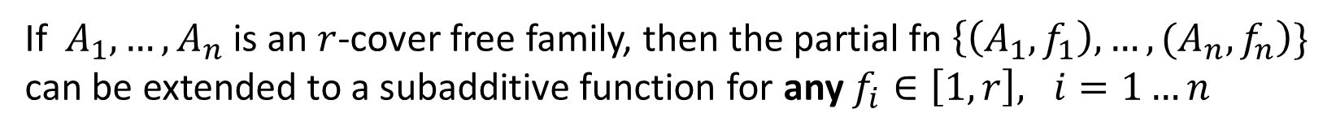
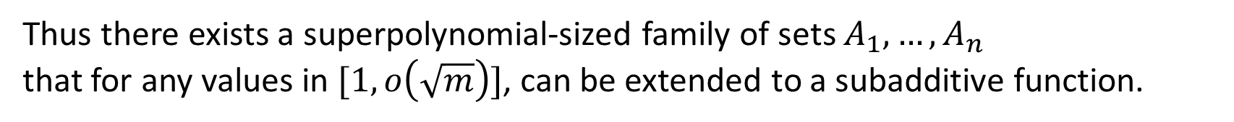
Subadditive Functions: Learning
Lemma:
If $A_{1},…, A_{n}$ is an $r$-cover free family, then the partial fn $\left\{\left(A_{1},f_{1}\right),…, {(A}_{n}, f_{n}\right)\}$ can be extended to a subadditive function for any $f_{i}∈\left[1,r\right], i=1…n$
Theorem:
For $r= o(\sqrt{m})$ , there exists an $r$-cover free family of size superpolynomial (in $m$)
[Dyachkov et al., 2014]
Thus there exists a superpolynomial-sized family of sets $A_{1},…, A_{n}$
that for any values in $[1, o\left(\sqrt{m}\right)]$, can be extended to a subadditive function.
By earlier argument, using uniform distribution over $A_{1},…, A_{n}$ ,
subadditive functions cannot be learned by any $o(\sqrt{m})$ factor.

Slide 36
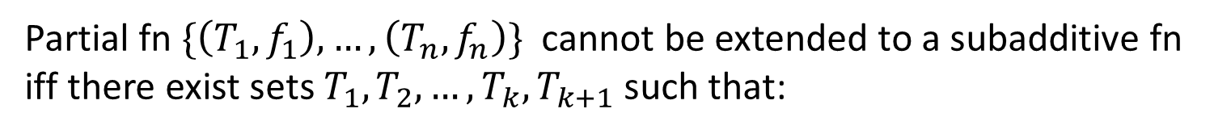

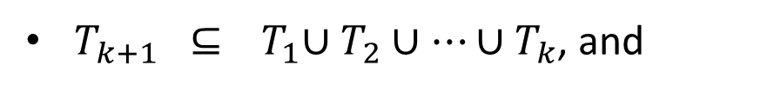
Subadditive Functions: Testing
There is a tester for subadditive functions that makes $2^{\frac{m}{2}+O\left(\sqrt{m log 1/ε} \right)}$ queries
Theorem:
Recall:
Lemma:
Partial fn $\{\left(T_{1},f_{1}\right), …, \left(T_{n}, f_{n}\right)\}$ cannot be extended to a subadditive fn
iff there exist sets $T_{1},T_{2},…, T_{k}, T_{k+1}$ such that:
$T_{k+1} ⊆{ T}_{1}∪T_{2}∪…∪T_{k}$, and
$f_{k+1} >{ f}_{1}+f_{2}+…+f_{k}$

Slide 37

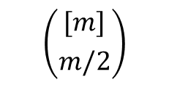

Subadditive Functions: Testing
There is a tester for subadditive functions that makes $2^{\frac{m}{2}+O\left(\sqrt{m log 1/ε} \right)}$ queries
Theorem:
Tester:
$$[m]$$
$$\left({[m] \atop m/2}\right)$$
$$∅$$

Slide 38
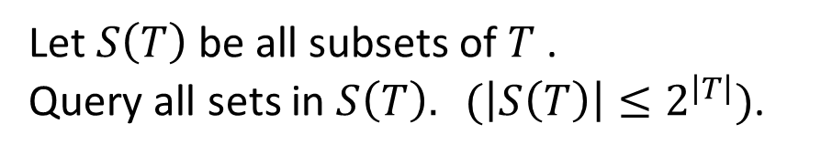



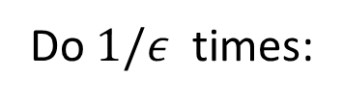

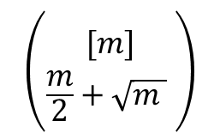

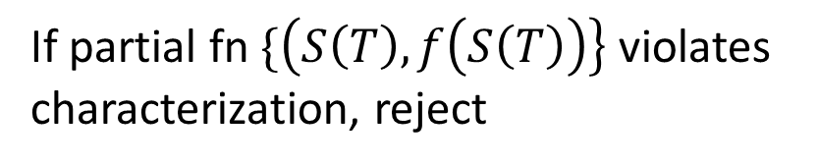
Subadditive Functions: Testing
There is a tester for subadditive functions that makes $2^{\frac{m}{2}+O\left(\sqrt{m log 1/ε} \right)}$ queries
Theorem:
Tester:
$$[m]$$
Do $1/ε$ times:
Choose $T :\left|T\right|≤\frac{m}{2}+\sqrt{m}$ uniformly
$$\left({[m] \atop \frac{m}{2}+\sqrt{m } }\right)$$
Let $S\left(T\right)$be all subsets of $T$ .
Query all sets in $S\left(T\right). (\left|S\left(T\right)\right|≤2^{\left|T\right|})$.
$$T_{2}$$
$$T_{1}$$
If partial fn $\{\left(S\left(T\right), f\left(S\left(T\right)\right)\right\}$ violates characterization, reject
$${S(T}_{2})$$
$${S(T}_{1})$$
Accept
$$∅$$

Slide 39
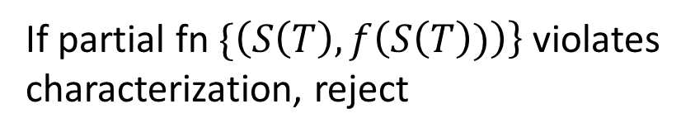
Subadditive Functions: Testing
There is a tester for subadditive functions that makes $2^{\frac{m}{2}+O\left(\sqrt{m log 1/ε} \right)}$ queries
Theorem:
Tester:
$$[m]$$
Do $1/ε$ times:
Choose $T :\left|T\right|≤\frac{m}{2}+\sqrt{m}$ uniformly
$$\left({[m] \atop \frac{m}{2}+\sqrt{m } }\right)$$
Let $S\left(T\right)$be all subsets of $T$ .
Query all sets in $S\left(T\right). (\left|S\left(T\right)\right|≤2^{\left|T\right|})$.
$$T_{2}$$
$$T_{1}$$
If partial fn $\{\left(S\left(T\right), f\left(S\left(T\right))\right)\right\}$ violates characterization, reject
$${S(T}_{2})$$
$${S(T}_{1})$$
Accept
$$∅$$

Slide 40
This Talk
Subadditive functions (extension, learning, testing)
Convex functions (extension)

Slide 41
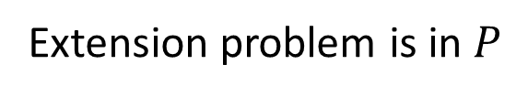
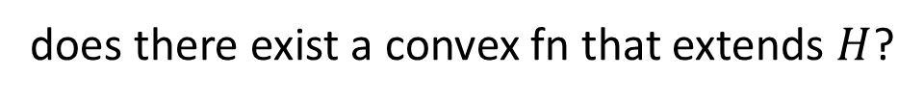

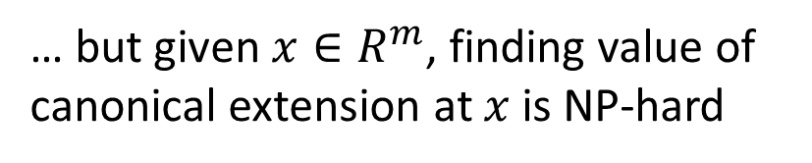
Our Results
Convex functions (domain $R^{\left[m\right]}$):
Given partial function
$H=\left\{\left(T_{1},f_{1}\right), \left(T_{2}, f_{2}\right), …, {(T}_{n}, f_{n}\right)\}$
does there exist a convex fn that extends $H$?
?
3
Extension problem is in $P$
2
… but given $x∈R^{m}$, finding value of canonical extension at $x$ is NP-hard
1
0
1
2
$$x$$

Slide 42

42
3
2
1
0
$$x$$
1
2

Slide 43





43
$$\min{ }\sum_{i=1}^{n}{λ_{i} f_{i}}$$
$\hat{f}\left(x\right) =$
$$\sum_{i=1}^{n}{λ_{i} T_{i}} = x$$
3
$$\sum_{i=1}^{n}{λ_{i} } = 1,$$
2
$$λ_{i} ≥ 0$$
1
0
$$x$$
1
2

Slide 44

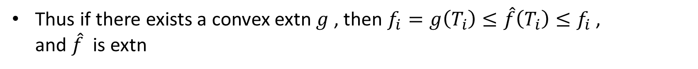
$$\min{ }\sum_{i=1}^{n}{λ_{i} f_{i}}$$
$\hat{f}\left(x\right) =$
will show $\hat{f}(⋅)$ is convex extension, if $H$ extendible
$$\sum_{i=1}^{n}{λ_{i} T_{i}} = x$$
3
$$\sum_{i=1}^{n}{λ_{i} } = 1,$$
2
$$λ_{i} ≥ 0$$
1
0
$$x$$
1
2
Then:
$\hat{f}\left(T_{i}\right) ≤{ f}_{i}$
If $g(⋅)$ is a convex extn of partial fn, then $g\left(x\right)≤\hat{f}(x)$ for feasible $x$
Thus if there exists a convex extn $g$ , then $f_{i}=g\left(T_{i}\right)≤\hat{f}\left(T_{i}\right)≤f_{i}$,
and $\hat{f}$ is extn

Slide 45

$$\min{ }\sum_{i=1}^{n}{λ_{i} f_{i}}$$
$\hat{f}\left(x\right) =$
$$\sum_{i=1}^{n}{λ_{i} T_{i}} = x$$
$$\sum_{i=1}^{n}{λ_{i} } = 1,$$
$$λ_{i} ≥ 0$$
If there exists a convex extn $g$ , then $\hat{f}$ is extn

Slide 46
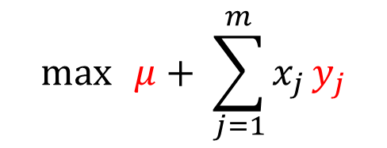
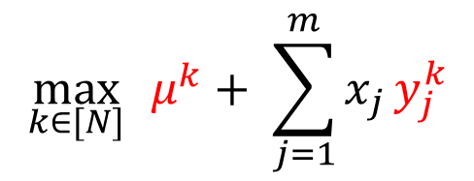

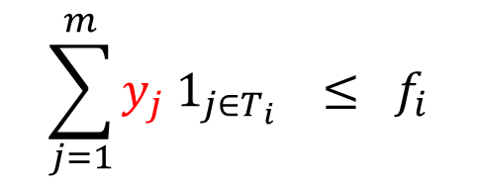
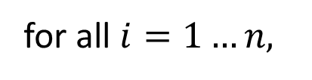
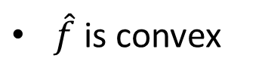
$$\min{ }\sum_{i=1}^{n}{λ_{i} f_{i}}$$
$$\max{ }μ+ \sum_{j=1}^{m}{x_{j}}y_{j}$$
$\hat{f}\left(x\right) =$
$$\sum_{i=1}^{n}{λ_{i} T_{i}} = x$$
$$\sum_{j=1}^{m}{y_{j} 1_{j∈T_{i}}} ≤ f_{i}$$
for all $i=1…n,$
$$\sum_{i=1}^{n}{λ_{i} } = 1,$$
$$λ_{i} ≥ 0$$
Let $\left(μ^{1}, {\overline{y}}^{1}\right), …,\left(μ^{N}, {\overline{y}}^{N}\right)$ be vertices of dual polyhedron
$$\max_{k∈[N]}{ }μ^{k}+ \sum_{j=1}^{m}{x_{j}}y_{j}^{k}$$
$\hat{f}\left(x\right) =$
If there exists a convex extn $g$ , then $\hat{f}$ is extn
$\hat{f}$ is convex
Thus $\hat{f}$ is convex extn, if partial fn is extendible

Slide 47
$$\min{ }\sum_{i=1}^{n}{λ_{i} f_{i}}$$
$$\max{ }μ+ \sum_{j=1}^{m}{x_{j}}y_{j}$$
$\hat{f}\left(x\right) =$
$$\sum_{i=1}^{n}{λ_{i} T_{i}} = x$$
$$\sum_{j=1}^{m}{y_{j} 1_{j∈T_{i}}} ≤ f_{i}$$
for all $i=1…n,$
$$\sum_{i=1}^{n}{λ_{i} } = 1,$$
$$λ_{i} ≥ 0$$
Let $\left(μ^{1}, {\overline{y}}^{1}\right), …,\left(μ^{N}, {\overline{y}}^{N}\right)$ be vertices of dual polyhedron
$$\max_{k∈[N]}{ }μ^{k}+ \sum_{j=1}^{m}{x_{j}}y_{j}^{k}$$
$\hat{f}\left(x\right) =$
$x$ in convex hull of $T_{1},…, T_{n}$: primal feasible, obtain $\hat{f}\left(x\right)$ by solving primal
$x$ NOT in convex hull of $T_{1},…, T_{n}$: obtaining $\hat{f}\left(x\right)$ is NP-hard

Slide 48
Further Results
This talk:
Subadditive functions
Submodular functions
Convex functions
Further work on:
XOS, matroid rank, coverage functions
Further work on submodular functions

Slide 49
Open Questions
Hardness of submodular extension?
Is submodular extension in NP / coNP?
Close gap in learning subadditive functions ( $O\left(\sqrt{m} log m\right), Ω\left(\sqrt{m}\right)$ )
Better testers for subadditive functions?
Further applications for partial function extension?
Thank You!

