Slide 1
APPROXIMATE DEGREE AND BOUNDED INDISTINGUISHABILITY
Andrej Bogdanov
Chinese University of Hong Kong
CAALM workshop, Chennai | January 2019

Slide 2
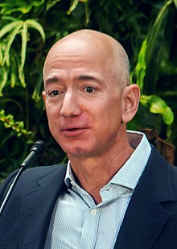
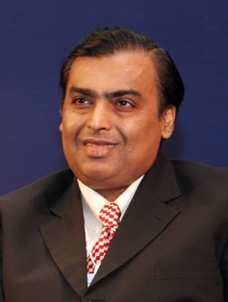
💰💰
💰
💰💰
💰💰
💰💰
💰💰
💰💰

Slide 3
secure multiparty computation
[Yao, Ben Or et al., Chaum et al.]

Slide 4
allows global computation
prevents local leakage
Is this reasonable?
Is this the best we can do?

Slide 5
Bounded indistinguishability
(X₁,…, X_{n}) and (Y₁,…, Y_{n}) are k-close if all their projections on size-k subsets are identical
Example
(X₁, X₂, X₃) uniform s.t. X₁ + X₂ + X₃ = 0
(Y₁, Y₂, Y₃) uniform s.t. Y₁ + Y₂ + Y₃ = 1

Slide 6
When does local closeness imply global closeness?
⨁
AC⁰
ROF
AND
NC⁰

Slide 7
I. THE BINARY ALPHABET

Slide 8
(X₁,…, X_{n}), (Y₁,…, Y_{n}) are bit sequences
μ, ν: {0, 1}^{n} → R their p.m.f.s
φ = μ – ν
local
global f
∑ φ(x) p(x) = 0
∑ φ(x) f(x) small
for all p of degree ≤ k

Slide 9
∑ φ(x) p(x) = 0
∑ φ(x) f(x) small
for all p of degree ≤ k
f has
approximate
degree ≤ k
if there
exists p: R^{n} → R of degree ≤ k such that
|f(x) – p(x)| ≤ ε for all x in {0, 1}^{n}

Slide 10
f cannot distinguish any k-close X, Y
if
and only if
deg_{ε} f ≤ k

Slide 11
Approximate degree of AND
x^{d}
x^{d}
T_{d}(x)
deg_{ε} AND = Θ(√ n log 1/ε)
[Nisan-Szegedy]

Slide 12





Slide 13

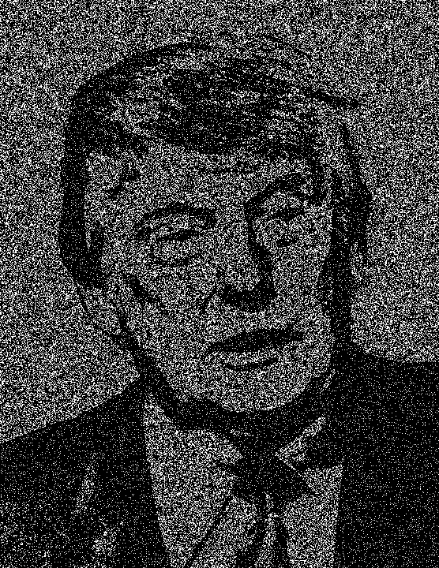
visual cryptography [Naor, Shamir]

Slide 14
secret sharing scheme
secret = or
1
0
shares = or
1
0
reconstruction function = AND

Slide 15
How to share
g(x) = E_{S}[Π_{i∈S} x_{i}]²
x ∈{–1, 1}^{n}
S
|S| ≤ (n – √n)/2
To share bit b,
sample x w/p ∝ g(x) | Πx_{i} = b

Slide 16
∑ φ(x) p(x) = 0
∑ φ(x) AND(x) large
for all p of degree ≤ k
φ = Π_{i∈S} x_{i} E_{S}[Π_{i∈S} x_{i}]²/Z
φ(1^{n}) = 1/Z
Z = ∑ E_{S}[Π_{i∈S} x_{i}]²
S
= Pr[S]

Slide 17
degree ≤ query complexity
exact ≤ deterministic
approximate ≤ randomized
≤ 2x quantum

Slide 18
Grover: deg≈ AND = O(√n)
Reichardt: deg≈ ∀ROF = O(√n)
open: Is deg≈ ∀ROF = Ω(√n)?

Slide 19
Composition
f
…
g
g
?
deg≈ f ∘ g ≥ deg≈ f deg≈ g

Slide 20
Composition
deg≈ ∀ROF₂ = Ω(√n)
[Sherstov, Bun-Thaler, …]
deg≈ ∀ROF_{d} = 2^{-O(d)} √n
[Ben-David et al.]

Slide 21
?
deg≈ ∃AC⁰ = Ω(n)
?
deg≈ ∃DNF = Ω(n)
deg≈ ∃AC⁰_{d} = n^{1 – 2}
-Ω(d)
[Bun-Thaler]
deg≈ ∀kDNF = O(n^{1 – 1/k})
[Sherstov]

Slide 22
Imperfect security
advantage
0
k = √n
coalition size
n
If X, Y are symmetric and k-close, then
they are (K, e^{-O(k /K)})-close for K ≤ n/4.
²
[Williamson]

Slide 23
Classical vs. quantum
If f requires k queries, then it requires Ω(k^{1/6}) quantum queries
[Nisan-Szegedy, Beals et al.]
If X, Y are (k, 0.01)-close, are they
(k^{1/10}, 0.1)-quantum close?

Slide 24
Indistingushability vs. independence
Polylog-wise independence fools AC⁰…
[Braverman]
…but √-wise indistingushability doesn’t

Slide 25
Indistingushability vs. independence
Common use: x = As for linear code A
Conjecture: If As and Bs are polylog-close, are they AC⁰-close?

Slide 26
II. LARGER ALPHABETS

Slide 27
There are Ω(n)-close X, Y that are separated by some AC⁰ function
[B.-Ishai-Viola-Williamson]
Alphabet size exponential in n
Conjecture: Ω(n) < n – 1

Slide 28
Ramp secret sharing
There are X, Y that are 49%n-close but AC⁰-far by any size 51%n coalitions
Here gap is necessary

Slide 29
For specific distributions originating in crypto, local closeness sometimes does imply AC⁰-security.
[Ishai et al., Faust et al., Rothblum]

Slide 30
CONCLUSION

