Slide 1
A Program Transformation For Faster Goal-Directed Search
Akash Lal, Shaz Qadeer
Microsoft Research

Slide 2
Optimizations
In the context of compilers, an optimization is:
  A program transformation that preserves semantics
  Aimed at improving the execution time of the program
We propose an optimization targeted towards program verification
  The optimization is semantics preserving
  Aimed at improving the verification time
  Targets “Deep Assertions”

Slide 3
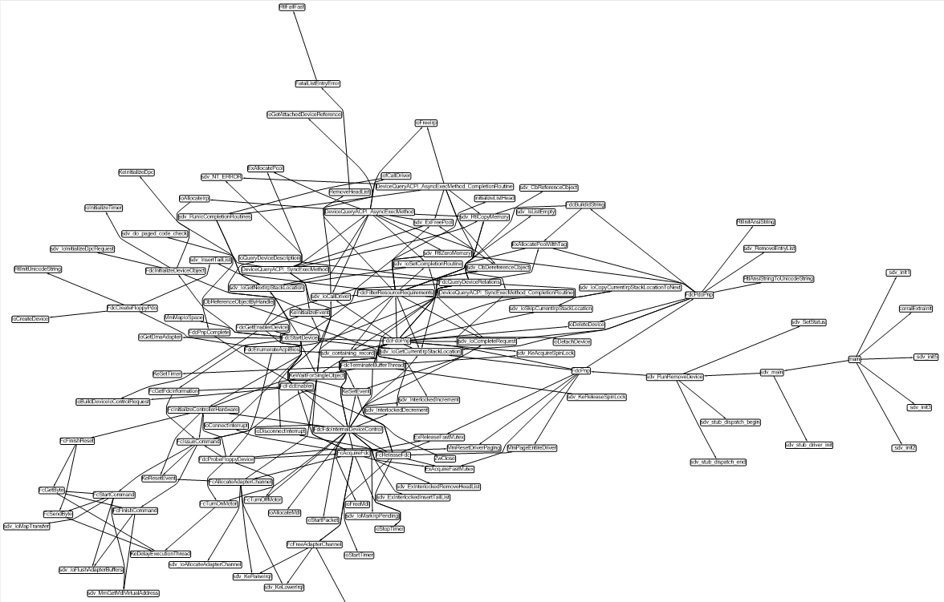
Deep Assertions
Assertion
Search in a large call graph
Main

Slide 4
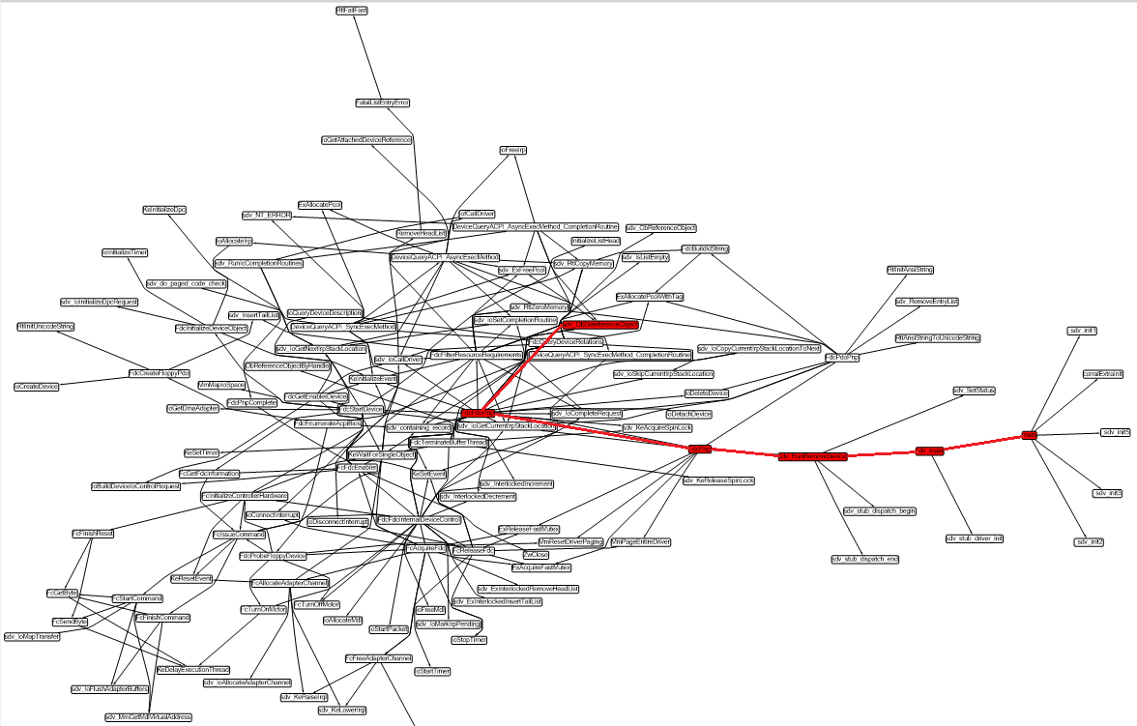
Deep Assertions
Search in a large call graph
Path of length 5

Slide 5
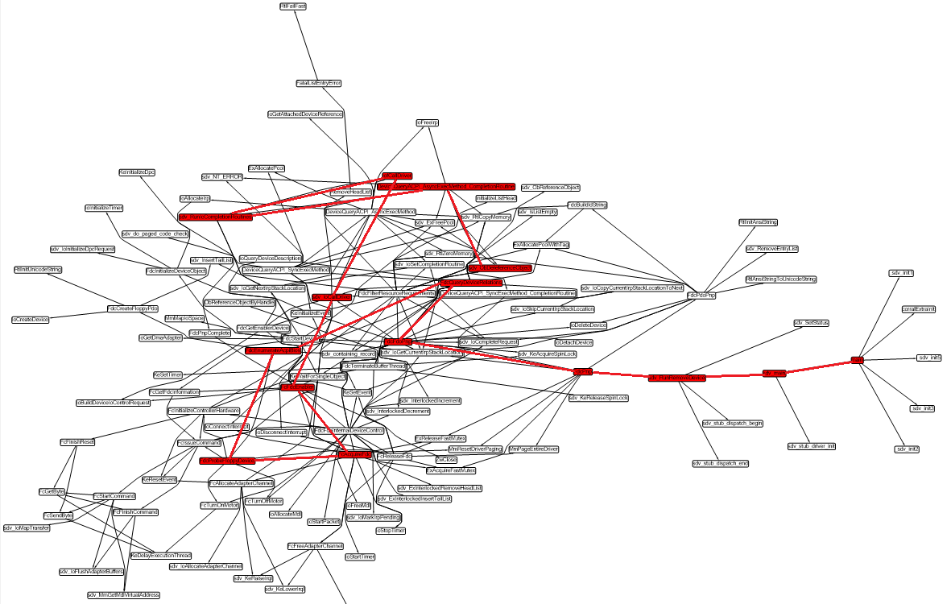
Deep Assertions
Search in a large call graph
Path of length 15

Slide 6
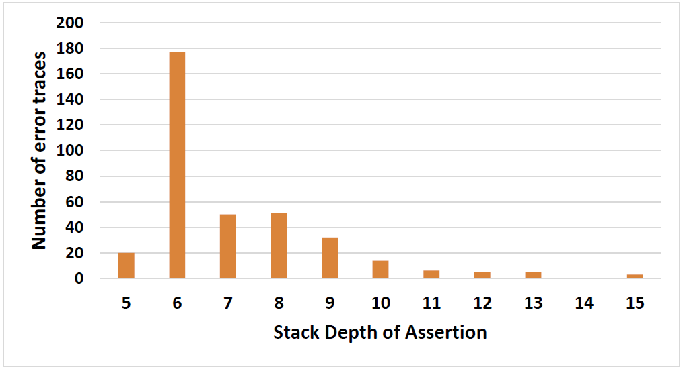
Deep Assertions
Statically, distance from main to the assertion was up to 38!

Slide 7
Deep Assertions
Goal-directed verifiers try to establish relevant information
  For instance, SLAM infers only predicates relevant to the property
  Contrast this with symbolic-execution-based testing or explicit modelcheckers that are not goal-directed
When the target is far away, knowing what is relevant is that much harder

Slide 8
Example
// global variables
var s, g: int;
procedure main()
{
// Initialization
s := 0; g := 1;
P1();
}
procedure P1()
{
P2();
P2();
}
procedure P2()
{
P3();
P3();
}
procedure Pn()
{
// loop
while(*) {
if(g == 1) Open();
Close();
}
}
procedure Open()
{
s := 1;
}
procedure Close()
{
assert s > 0;
s := 0;
}
Deep call graph!

Slide 9
Inlining-Based Verifiers
Example: BMC, Corral
Based on exploring the call graph by unfolding it
  Inline procedures, unroll loops
  Either in forward or backward direction
  Use invariants to help prune search

Slide 10
Lazy Inlining Algorithms

Slide 11
Example
// global variables
var s, g: int;
procedure main()
{
// Initialization
s := 0; g := 1;
P1();
}
procedure P1()
{
P2();
P2();
}
procedure P2()
{
P3();
P3();
}
procedure Pn()
{
// loop
while(*) {
if(g == 1) Open();
Close();
}
}
procedure Open()
{
s := 1;
}
procedure Close()
{
assert s > 0;
s := 0;
}
Corral, forward
Full inlining: O(2^n)*R, Or
Produce the invariant for each Pi:
(old(g) == 1 && old(s) == 0) ==> (s == 0 && !err)
Corral, backward
Full inlining: O(2^n)*R, Or
Produce the precondition for each Pi:
(g == 1)

Slide 12
Example
// global variables
var s, g: int;
procedure main()
{
// Initialization
s := 0; g := 1;
P1();
}
procedure P1()
{
P2();
P2();
}
procedure P2()
{
P3();
P3();
}
procedure Pn()
{
// loop
while(*) {
if(g == 1) Open();
Close();
}
}
procedure Open()
{
s := 1;
}
procedure Close()
{
assert s > 0;
s := 0;
}
After our transformation:
Corral, forward: O(1)
Corral, backward: O(1)
No invariants needed!

Slide 13
Our Transformation
Key Guarantee: Lift all assertions to main, that is for any procedure call, it will be to a procedure that cannot fail
How?
Call-Return semantics: a procedure call stores the return address on the stack, jumps to the procedure, and on exit returns to the address on stack.
When a procedure call doesn’t fail, then we already have our guarantee
When a procedure call will fail then we don’t need the return address!

Slide 14
Our Transformation
{
...
// guess if the call fails
if(*) {
// it does!
goto foo_start;
} else {
// it doesn’t!
call foo();
}
...
}
foo_start:
…
assert blah;
…
halt;
{
...
call foo();
...
}
procedure foo()
{
foo_start:
…
assume blah;
…
return;
}
procedure foo()
{
foo_start:
…
assert blah;
…
return;
}

Slide 15
Our Transformation
main()
{
A;
call foo();
B; assert e1;
}
foo()
{
call bar();
C; assert e2;
}
bar()
{
D; assert e3;
}
main() {
A;
call foo();
B; assert e1;
}
foo() {
call bar();
C; assume e2;
}
bar() {
D; assume e3;
}

Slide 16
Our Transformation
main()
{
A;
call foo();
B; assert e1;
}
foo()
{
call bar();
C; assert e2;
}
bar()
{
D; assert e3;
}
main() {
A;
if(*) {
goto foo_start;
} else {
call foo();
}
B; assert e1;
}
foo() {
call bar();
C; assume e2;
}
bar() {
D; assume e3;
}

Slide 17
Our Transformation
main()
{
A;
call foo();
B; assert e1;
}
foo()
{
call bar();
C; assert e2;
}
bar()
{
D; assert e3;
}
main() {
A;
if(*) {
goto foo_start;
} else {
call foo();
}
B; assert e1;
}
foo() {
call bar();
C; assume e2;
}
bar() {
D; assume e3;
}
foo_start:
call bar();
C; assert e2;
halt;

Slide 18
Our Transformation
main()
{
A;
call foo();
B; assert e1;
}
foo()
{
call bar();
C; assert e2;
}
bar()
{
D; assert e3;
}
main() {
A;
if(*) {
goto foo_start;
} else {
call foo();
}
B; assert e1;
}
foo() {
call bar();
C; assume e2;
}
bar() {
D; assume e3;
}
foo_start:
if(*) {
goto bar_start;
} else {
call bar();
}
C; assert e2;
halt;

Slide 19
Our Transformation
main()
{
A;
call foo();
B; assert e1;
}
foo()
{
call bar();
C; assert e2;
}
bar()
{
D; assert e3;
}
main() {
A;
if(*) {
goto foo_start;
} else {
call foo();
}
B; assert e1;
}
foo() {
call bar();
C; assume e2;
}
bar() {
D; assume e3;
}
foo_start:
if(*) {
goto bar_start;
} else {
call bar();
}
C; assert e2;
halt;
bar_start:
D; assert e3;
halt;
Remarks:
The algorithm terminates
At most one copy of each procedure absorbed into main (unlike inlining)
All assertions in main!
Semantically equivalent

Slide 20

Our Transformation
Additional Guarantee: Loops don’t have assertions
How?
Only the last iteration can fail
loop(b)
loop(b); if(*) { b }
loop($\overline{b}$); if(*) { b }

Slide 21
Example
// global variables
var s, g: int;
procedure main()
{
// Initialization
s := 0; g := 1;
P1();
}
procedure P1()
{
P2();
P2();
}
procedure P2()
{
P3();
P3();
}
procedure Pn()
{
// loop
while(*) {
if(g == 1) Open();
Close();
}
}
procedure Open()
{
s := 1;
}
procedure Close()
{
assert s > 0;
s := 0;
}
Deep call graph!

Slide 22
Example
var s, g: int;
procedure main()
{
s := 0; g := 1;
if(*) goto P1_start;
else P1();
return;
P1_start:
if(*) goto P2_start;
else P2();
if(*) goto P2_start;
else P2();
return;
...
Pn_start:
while(*) {
if(g == 1) Open();
Close();
}
if(*) {
if(g == 1) Open();
if(*) {
assert s > 0;
s := 0;
} else Close();
}
} // end main
Inline: Open
ensures s == 1

Slide 23
Transforming Concurrent Programs
Concurrent Programs: We still retain our guarantee
Key Idea: At most one thread can fail
Main thread guesses the failing thread upfront and starts running it
(But it blocks until the thread is actually spawned)
Rest all of the threads run failure free
Failing thread transformed, as for sequential programs

Slide 24
Programming Model
Execution starts in main
Additional threads can be spawned as: async call foo(x)
Preemptions are explicit: yield
Note: unbounded threads, but finite (fixed) number of thread entrypoints

Slide 25
Transforming Concurrent Programs
{
...
// guess if this is the failing thread
if(*) {
// it is not
async call foo(x);
} else {
// it is
assume flag == nil;
a := x;
flag := “foo”;
}
...
}
{
...
async call foo(x);
...
}

Slide 26
Transforming Concurrent Programs
{
  flag := nil;
  if(*) { flag := “main”; goto main_entry; }
  async call main(); yield;
  goto l_{foo}, l_{bar};
  l_{foo}:
  assume flag == “foo”; args := a; goto foo_start;
  l_{bar}:
  assume flag == “bar”; args := a; goto bar_start;
  main_entry:
  <main>; die;
  foo_entry:
  <foo>; die;
  bar_entry:
  <bar>; die;
}
main

Slide 27
Evaluation
Two verifiers
  Corral: Based on procedure inlining
  Yogi: Based on testing and refinement via lazy predicate abstraction
Implementation
  Less than 1000 lines of code!
Evaluation Criteria
  Number of instances solved
  Running time
  Memory consumption
  Effect on summary generation (discussed in the paper)

Slide 28
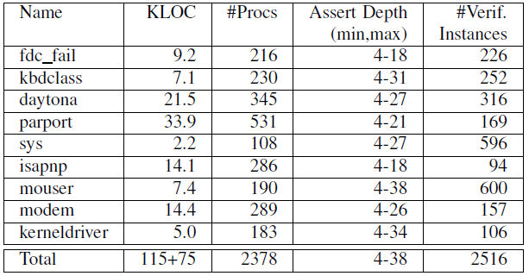
Benchmarks (Sequential)
Windows Device Drivers, source: “The Static Driver Verifier”

Slide 29
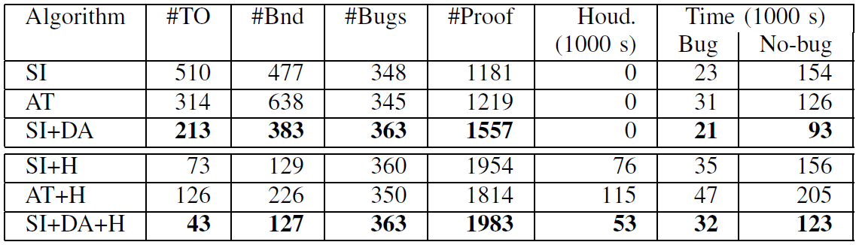
Summary of the Results

Slide 30
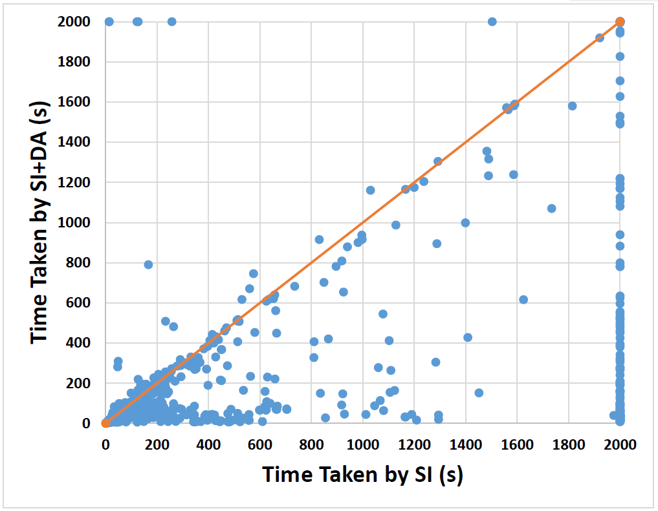
Results: SI
Number of instances: 2516
Reduction in Timeouts: 297
10X speedup: 54
2X speedup: 220
2X slowdown: 5
Program size increase: 1.1X to 1.6X
Memory consumption: reduced!

Slide 31
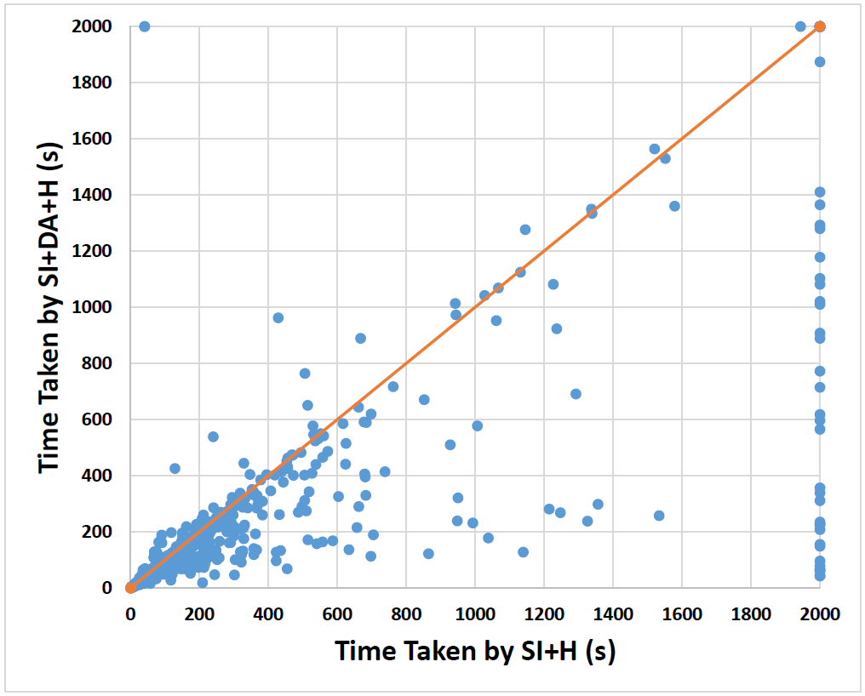
Results: SI+Houdini
Number of instances: 2516
Reduction in Timeouts: 30
2X speedup: 80
2X slowdown: 4

Slide 32
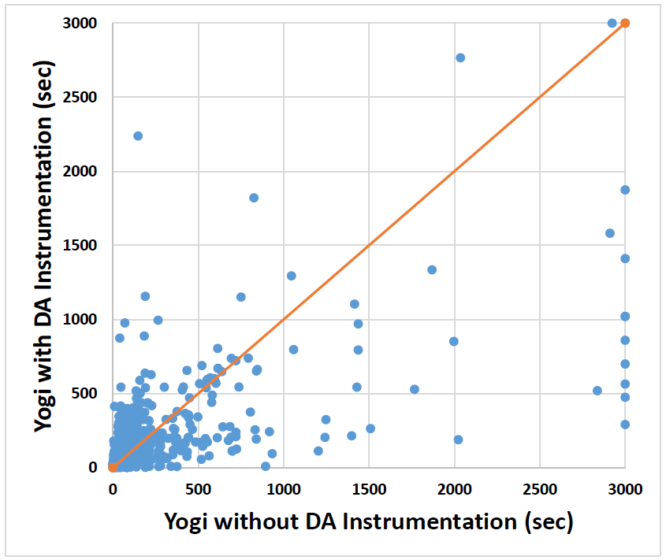
Results: Yogi
Third party tool
Number of instances: 802
Reduction in Timeouts: 7
10X speedup: 36
Slowdown mostly limited to trivial instances

Slide 33
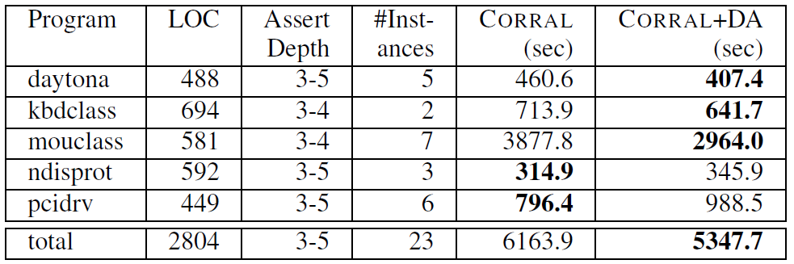
Results on Concurrent Programs

Slide 34
Summary
A program transformation that lifts all assertions to main
Considerable speedups, up to 10X for two different verifiers
Very little implementation effort
Try it out in your verifier today!
Thank You!

