Slide 1

Combinatorial Topology and
Distributed Computing
TexPoint fonts used in EMF.
Read the TexPoint manual before you delete this box.: AAAAAAA

Slide 2
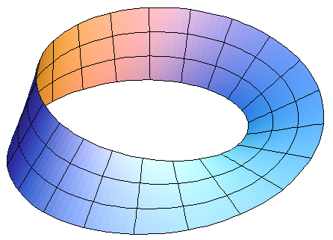
Part Two
Elements of Combinatorial Topology

Slide 3
Overview
Basic concepts of Combinatorial Topology
How they model distributed & concurrent computation
Duality between
combinatorial & continuous mechanisms

Slide 4
A Vertex
Combinatorial: an element of a set.
Geometric: a point in high-dimensional Euclidean Space

Slide 5
Simplexes
Combinatorial: a set of vertexes.
Geometric: convex hull of points in general position
0-simplex
1-simplex
dimension
2-simplex
3-simplex

Slide 6
Simplicial Complex
Combinatorial: a set of simplexes close under inclusion.
Geometric: simplexes “glued together” along faces …

Slide 7
Simplicial Maps
Vertex-to-vertex map …

Slide 8
Simplicial Map
Vertex-to-vertex map …
that sends simplexes to simplexes
piece-wise linear map on geometric simplexes

Slide 9
Carrier Map
M
Maps simplex …
to subcomplex.
Preserves intersections: M (¾ Å ¿) = M (¾) Å M (¿)

Slide 10
Vertex = Process State
Process ID (color)
7
Value (input or output)

Slide 11
Simplex = Global State

Slide 12
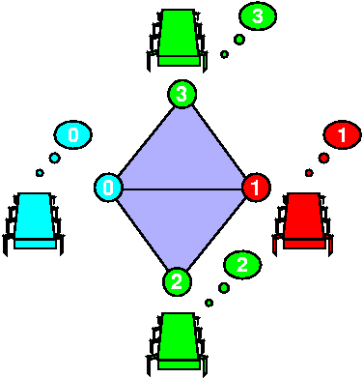
Complex = Global States

Slide 13
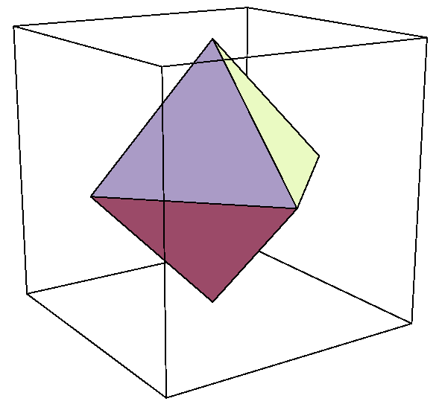
Input Complex for Binary Consensus
0
All possible initial states
0
1
0
Processes: red, green, blue
1
Independently assigned 0 or 1

Slide 14
Output Complex for Binary Consensus
All possible final states
0
0
0
1
Output values all 0 or all 1
1
1
Two disconnected simplexes

Slide 15
Carrier Map for Consensus
All 0 outputs
All 0 inputs

Slide 16
Carrier Map for Consensus
All 1 inputs
All 1 outputs

Slide 17
Carrier Map for Consensus
All 0 outputs
Mixed 0-1 inputs
All 1 outputs

Slide 18
Task Specification
(I, O, ¢)
Input complex
Carrier map
Output complex

Slide 19
Protocol
view = my input value;
for (i = 0; i < r; i++) {
broadcast view;
view += messages received;
}
return δ(view)
Finite program

Slide 20
Protocol
view = my input value;
for (i = 0; i < r; i++) {
broadcast view;
view += messages received;
}
return δ(view)
Start with input value

Slide 21
Protocol
view = my input value;
for (i = 0; i < r; i++) {
broadcast view;
view += messages received;
}
return δ(view)
Run for fixed number of rounds

Slide 22
Protocol
view = my input value;
for (i = 0; i < r; i++) {
broadcast view;
view += messages received;
}
return δ(view)
Send current view to others

Slide 23
Protocol
view = my input value;
for (i = 0; i < r; i++) {
broadcast view;
view += messages received;
}
return δ(view)
Concatenate messages received to view
(full-information protocol)

Slide 24
Protocol
view = my input value;
for (i = 0; i < r; i++) {
broadcast view;
view += messages received;
}
return δ(view)
finally, apply task-specific decision map to view

Slide 25
Protocol Complex
Vertex: process ID, view
Complete log of messages sent & received
Simplex: compatible set of views
Each execution defines a simplex

Slide 26
Example: Synchronous Message-Passing
Round 0
Round 1

Slide 27
Failures: Fail-Stop
Partial broadcast

Slide 28
Single Input: Round Zero
No messages sent
0
View is input value
0
0
Same as input simplex

Slide 29
Round Zero Protocol Complex
0
No messages sent
0
1
View is input value
0
1
Same as input complex

Slide 30
Single Input: Round One
0
0
0
0
0
0
0
0
0
0
0
0
0
0
0
0
0
0
0
0
0

Slide 31
Single Input: Round One
0
0
0
0
0
0
0
0
0
0
0
0
0
0
0
0
0
no one fails
0
0
0
0

Slide 32
Single Input: Round One
0
0
0
0
0
0
0
0
0
0
0
0
0
0
0
0
0
no one fails
blue fails
0
0
0
0

Slide 33
Single Input: Round One
red fails
green fails
0
0
0
0
0
0
0
0
0
0
0
0
0
0
0
0
0
no one fails
blue fails
0
0
0
0

Slide 34
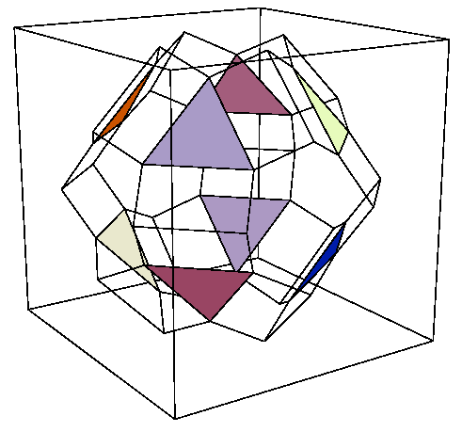
Protocol Complex: Round One

Slide 35
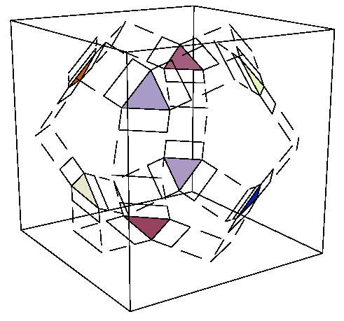
Protocol Complex: Round Two

Slide 36
Protocol Complex Evolution
zero
one
two

Slide 37
Summary
protocol complex
δ
input complex
output complex
Δ

Slide 38
Decision Map
δ
Simplicial map, sending simplexes to simplexes
Protocol complex
Output complex

Slide 39
Lower Bound Strategy
δ
Find topological “obstruction” to this simplicial map
Protocol complex
Output complex

Slide 40
Consensus Example
Subcomplex of all-0 inputs
Must map here
0
0
δ
1
1
Protocol
Output

Slide 41
Consensus Example
0
0
δ
1
1
Protocol
Subcomplex of all-1 inputs
Must map here
Output

Slide 42
Consensus Example
Image under δ must start here ..
0
0
δ
1
1
Protocol
Path from
“all-0” to “all-1”
Output
and end here

Slide 43
Consensus Example
path
0
0
δ
?
1
1
Output

Slide 44
Consensus Example
Image under δ must start here ..
But this “hole” is an obstruction
δ
Protocol
Path from
“all-0” to “all-1”
Output
and end here

Slide 45
Conjecture
A protocol cannot solve consensus if its complex is path-connected
Model-independent!

Slide 46
If Adversary keeps Protocol Complex path-connected …
Forever …
Consensus is impossible
For r rounds …
A round-complexity lower bound
For time t …
A time-complexity lower bound

Slide 47
Another Conjecture
A protocol cannot solve k-set agreement if its complex has “no holes” in dimensions < k
Later!

Slide 48
This work is licensed under a Creative Commons Attribution-Noncommercial 3.0 Unported License.

