Slide 1
Combinatorial Topology and Distributed Computing
TexPoint fonts used in EMF.
Read the TexPoint manual before you delete this box.: AAAAAAA

Slide 2
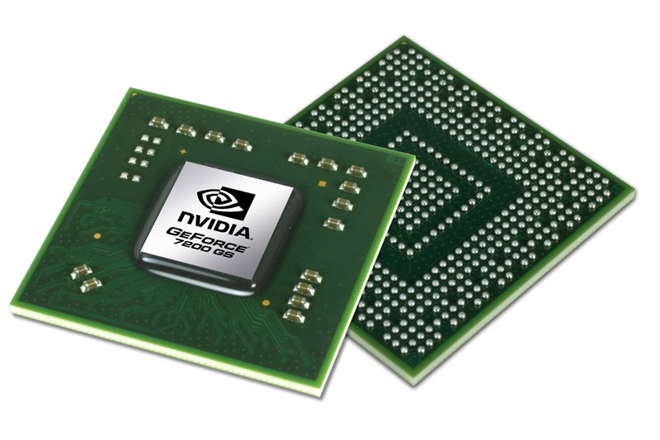
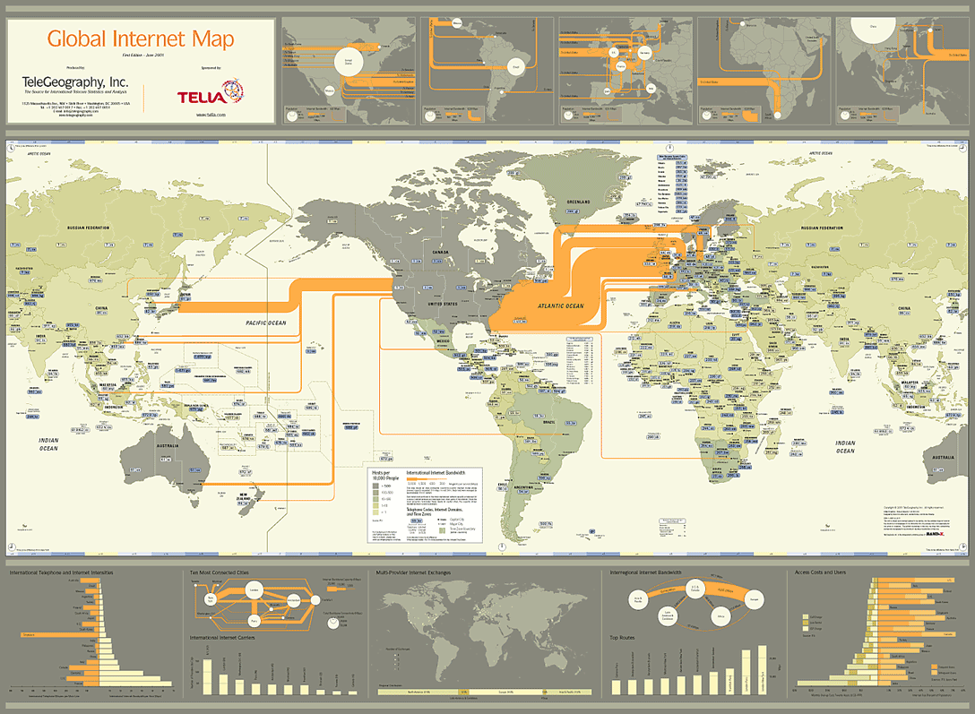
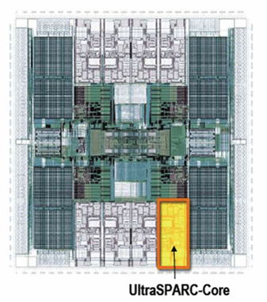
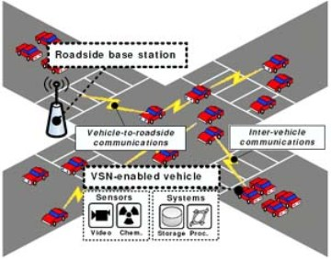
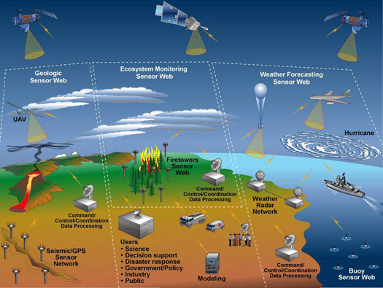
Part One What is Distributed Computing?

Slide 3
In the Beginning …
1
0
1
1
0
1
0
a computer was just a Turing machine …
Notes:
In the beginning, a computer was a single processor. A rich theory grew up studying what single processors can and can’t do.

Slide 4
Today
?
?
?
Computing is co-ordination and communication
4
Notes:
Today, however, there are many computers. Sometimes these computers are very far apart, as on the Internet. Sometimes they are closer, as in a sensor network. Sometimes they are close, as in a multicore chip. And sometimes they are very close, as in a graphics processor.

Slide 5
Here is a puzzle ….

Slide 6
Each process has an input …
32
19
21
6
Notes:
Consensus is an innocuous-looking, somewhat abstract problem that will have enormous consequences for
everything from algorithm design to hardware architecture. We have a collection of processes. Each process starts with a private input, known only to itself. This input can be a message it received, a character typed at a keyboard, or a signal from a sensor.

Slide 7
They Communicate …
Notes:
The processes communicate among themselves. This communication can take any form. Processes can send messages to one another, they can read and write a shared memory, or they can send carrier pigeons.

Slide 8
All Agree on One Input
19
19
19
consensus
Notes:
Eventually, after a finite number of steps, they must all agree on some process’s input. Simple agreement is not enough, because they could trivially all decide zero, so we require that the agreement value be some process’s input.

Slide 9
Why is this problem hard?
?
?
(sleeping)
Notes:
Why is this problem hard? Well, some processes might be much slower than others, so some processes might have to decide without waiting to hear from everyone. Why can’t they just wait?

Slide 10
Why is this problem hard?
?
?
Notes:
Processes can fail. In some systems, a failed process might be indistinguishable from a slow process.

Slide 11
Why is this problem hard?
(sleeping)
(sleeping)
Notes:
For example, in a system where processes run at different speeds or communication is unreliable, a crashed process may be indistinguishable from a very slow process.

Slide 12
Why is this problem hard?
(sleeping)
Notes:
Of course, a very slow process may be indistinguishable from a crashed process.

Slide 13
Tasks
32
19
Possible set of input values
21
Finite computation
Possible set of output values
19
19
32
32
19
21
21
32
21

Slide 14
Agree on · k Inputs
19
19
21
k-set agreement
Notes:
Eventually, after a finite number of steps, they must all agree on some process’s input. Simple agreement is not enough, because they could trivially all decide zero, so we require that the agreement value be some process’s input.

Slide 15
Renaming: Autonomous Air Traffic Control
36,000 f t
DL227
35,000 f t
34,000 f t
33,000 f t
AL991
AA082
32,000 f t
31,000 f t
Pick your own altitude.
How many slots do we need?
renaming
Notes:
Transponder collusion avoidance system

Slide 16
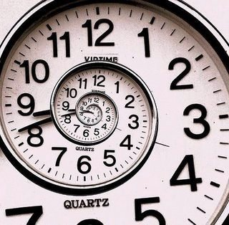
There are Many Models
Communication?
Failures?
Timing?
Notes:
In distributed computing, there are many legitimate models of computation. This variety may seem confusing at first, but all these models, different as they are, share common properties.

Slide 17
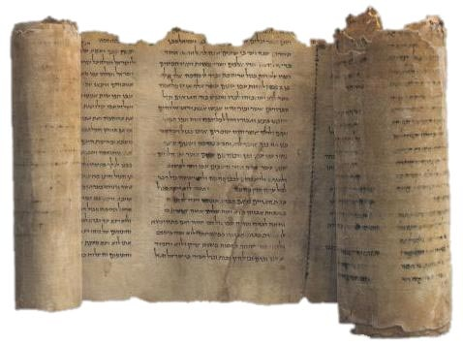
Communication
Message-Passing
Read-Write Memory
Black-Box Memory

Slide 18
Message-Passing

Slide 19
Read-Write Memory

Slide 20
Read-Write Models
write & read individual locations
write & take memory snapshot
Group writes together then
takes snapshots together

Slide 21
Round-By-Round

Slide 22
Black Box Memory
Compare-and-swap
Fetch-and-add

Slide 23
Failures
Crash failures: processes halt
How many?
Which ones?
Notes:
Failures are halting failures: a process simply stops and takes no more steps. When designing a protocol, it is important to know what kinds of failures your protocol must tolerate.

Slide 24
Wait-Free Failure Model
All but one may crash
Notes:
In the wait-free model, all but one of the processes can fail. This is the most demanding model.

Slide 25
t-Resilient Failure Model
At most t may crash
Here, t = 1.
Notes:
In the t-resilient model, at most t process can crash. If t < n-1, this model is less demanding than the wait-free model.

Slide 26
Correlated Failures
Processes on same server may crash
Notes:
Both the wait-free and t-resilient models assume failures are independent. In real life, failures are often not independent. In this example, the red and greed processes reside at one server, and the purple at another. Protocol designers should expect that red and green fail together, or purple fails by itself.

Slide 27
Adversaries
Determine which sets of processes can halt.
“worst-case” scenario

Slide 28
Timing Models
Processes share a clock
Synchronous
Processes do not share a clock
Asynchronous
Processes have approximately-synchronized clocks
Semi-synchronous
Notes:
It is important to understand how time works. Protocol design is easier if processes share a common clock: they take steps at the same rate, and one process can wait for another. Protocol design is harder if processes run at different speeds. In the middle, processes might run at different speeds, but not too different.

Slide 29
Synchronous
Notes:
In synchronous models, processes take steps at the same rate. After the red process takes a step, it knows the blue process has also taken a step.
Synchronous comes from Greek: syn = together, chronos = time.

Slide 30
Synchronous Failures
!
detection easy
Notes:
One advantage of the synchronous model is that one process can easily detect when another has failed.

Slide 31
Asynchronous
Notes:
In asynchronous models, processes take steps at any rate.
Asynchronous comes from Greek: a (not) + synchronous (at the same time).
Synchronous comes from Greek: syn = together, chronos = time.

Slide 32
Asynchronous Failures
??
detection impossible
Notes:
The asynchronous model is difficult because it is impossible to tell whether another process has failed or is just slow.

Slide 33
Semi-Synchronous
Notes:
In the semi-synchronous model, processes may take steps at different speeds, but there is a bound on the difference. Here, for example, each time one process takes two steps, the other must take one.
Semi-synchronous is a awkward mixture of semi (Latin for partly) and synchronous (Greek for “at the same time”).

Slide 34
Semi-Synchronous Failures
!
detection slow
Notes:
In semi-synchronous model, it is possible for one process can detect when another has failed, but such detection is usually expensive, since one processor must wait for a long time before it can detect that another has failed.
The word

Slide 35
Computation Model Space
asynchronous
semi-synchronous
adversaries
t-resilient
synchronous
wait-free
messages
read-write
black-box
Which combinations make sense?
35
Notes:
35
The space of registers can be divided into three dimensions, where the number of readers and writers is one dimension, the register size is another, and the strength of the correctness condition is a third.

Slide 36
Multicores
Sun T2000
Niagara
Asynchronous
Wait-free
Shared Memory

Slide 37
Distributed Computing
Internet
Asynchronous
Message-passing
Sensor
network

Slide 38
Parallel Computing
Synchronous
Message-passing
(or shared memory)
GPU

Slide 39
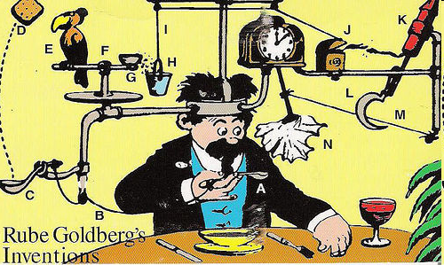
Operational Reasoning

Slide 40
Combinatorial Reasoning
Model-independent properties …
… restricted model-dependent reasoning

Slide 41
This work is licensed under a Creative Commons Attribution-ShareAlike 2.5 License.
You are free:
to Share — to copy, distribute and transmit the work
to Remix — to adapt the work
Under the following conditions:
Attribution. You must attribute the work to “The Art of Multiprocessor Programming” (but not in any way that suggests that the authors endorse you or your use of the work).
Share Alike. If you alter, transform, or build upon this work, you may distribute the resulting work only under the same, similar or a compatible license.
For any reuse or distribution, you must make clear to others the license terms of this work. The best way to do this is with a link to
http://creativecommons.org/licenses/by-sa/3.0/.
Any of the above conditions can be waived if you get permission from the copyright holder.
Nothing in this license impairs or restricts the author's moral rights.

